Slide 1
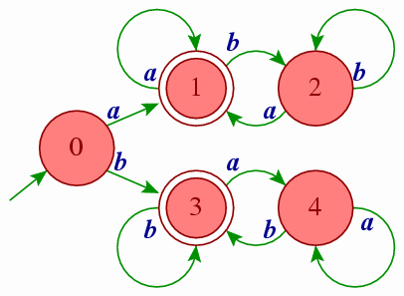
Unit-2
Regular Languages & Finite Automata

Slide 2
Topics to be covered
Language
Regular expressions & Regular languages
Finite Automata
Union, Intersection and Complement of Regular Languages
Non-Deterministic Finite Automata
Conversion from NFA to FA
^ - Non-Deterministic Finite Automata
Conversion of NFA-^ to FA
Kleene’s Theorem Part – I
Finite Automata with Output (Moore machine, Mealy machine)
Minimization of FA
Moore machine & Mealy machine
Pumping Lemma – Regular and Non Regular Languages

Slide 3
Languages

Slide 4
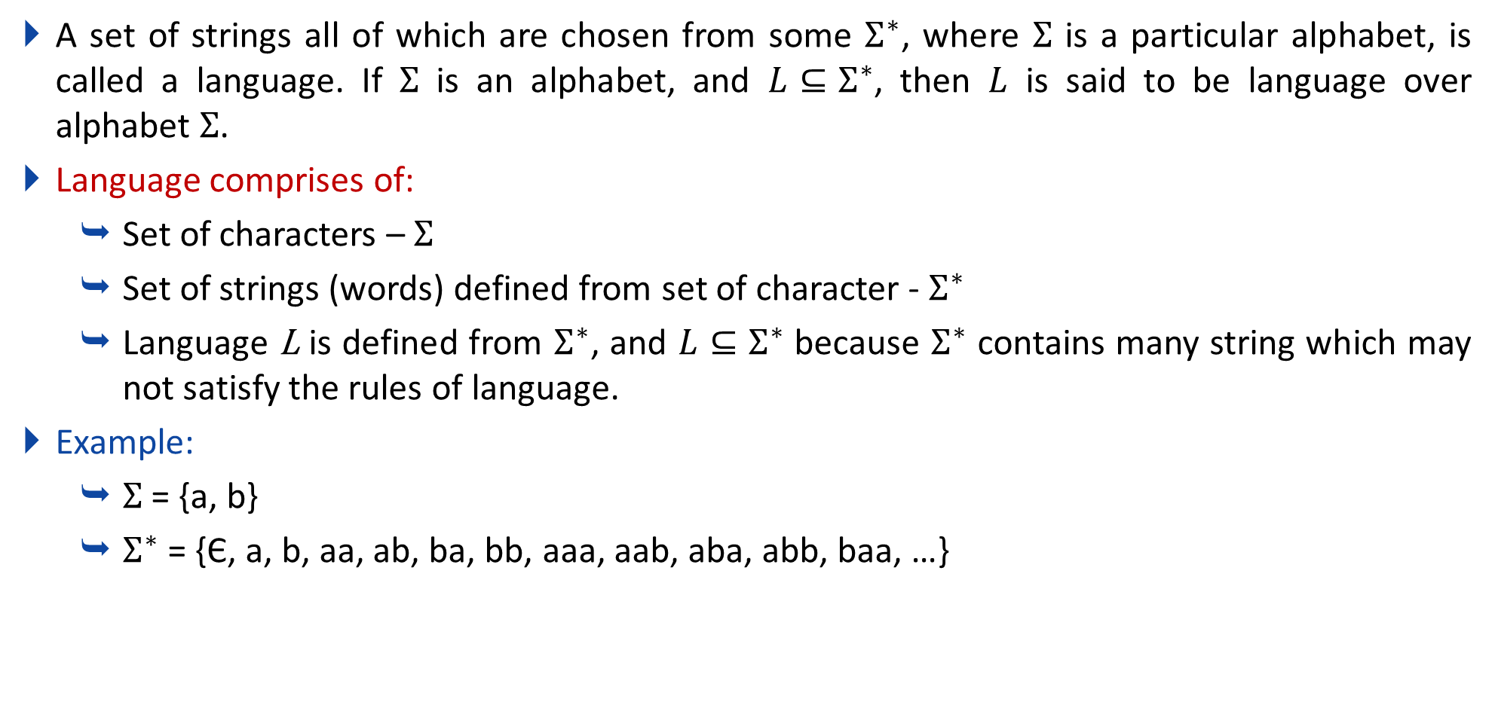
Language
A set of strings all of which are chosen from some $Σ^{∗}$, where $Σ$ is a particular alphabet, is called a language. If $Σ$ is an alphabet, and $L⊆Σ^{∗}$, then $L$ is said to be language over alphabet $Σ$.
Language comprises of:
Set of characters – $Σ$
Set of strings (words) defined from set of character - $Σ^{∗}$
Language L is defined from $Σ^{∗}$, and $L⊆Σ^{∗}$ because $Σ^{∗}$ contains many string which may not satisfy the rules of language.
Example:
$Σ$ = {a, b}
$Σ^{∗}$ = {Є, a, b, aa, ab, ba, bb, aaa, aab, aba, abb, baa, …}

Slide 5
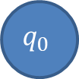

Difference between epsilon and phi
Epsilon(Є) is a 0 length string, whereas phi(ɸ) is a null, i.e. no string.
0,1
$$q_{0}$$
$$q_{0}$$
Epsilon(Є)
phi(ɸ)

Slide 6
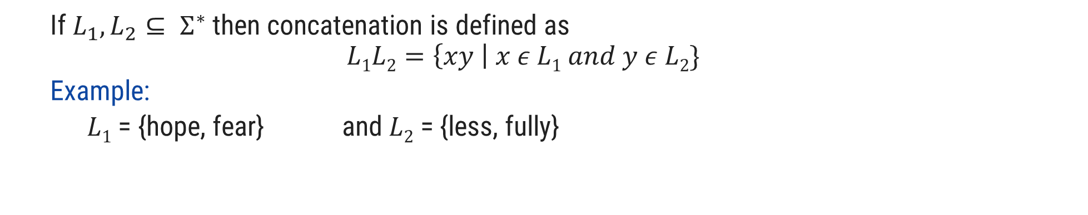
Operations over Language
Operations over the language are:
Concatenation
Union
* (Kleene closure)
+ (Positive closure)
If $L_{1}, L_{2}⊆ Σ^{∗}$ then concatenation is defined as
$$L1L2=\left\{xy \right| x ε L1 and y ε L2\}$$
Example:
$L1$ = {hope, fear} and $L2$ = {less, fully}
hopeless
$L1L2$ = {hopeless, hopefully, fearless, fearfully}

Slide 7

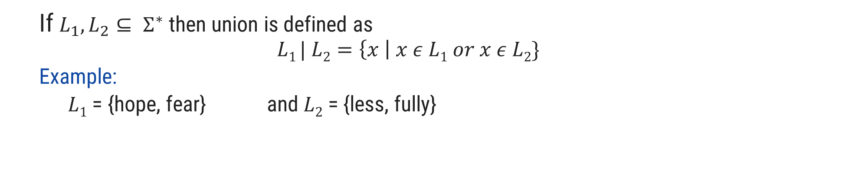
Operations over Language
Operations over the language are:
Concatenation
Union
* (Kleene closure)
+ (Positive closure)
If $L_{1}, L_{2}⊆ Σ^{∗}$ then union is defined as
$$L1 | L2=\left\{x \right| x ε L1 or x ε L2\}$$
Example:
$L1$ = {hope, fear} and $L2$ = {less, fully}
$L1 | L2$ = {hope, fear, less, fully}

Slide 8

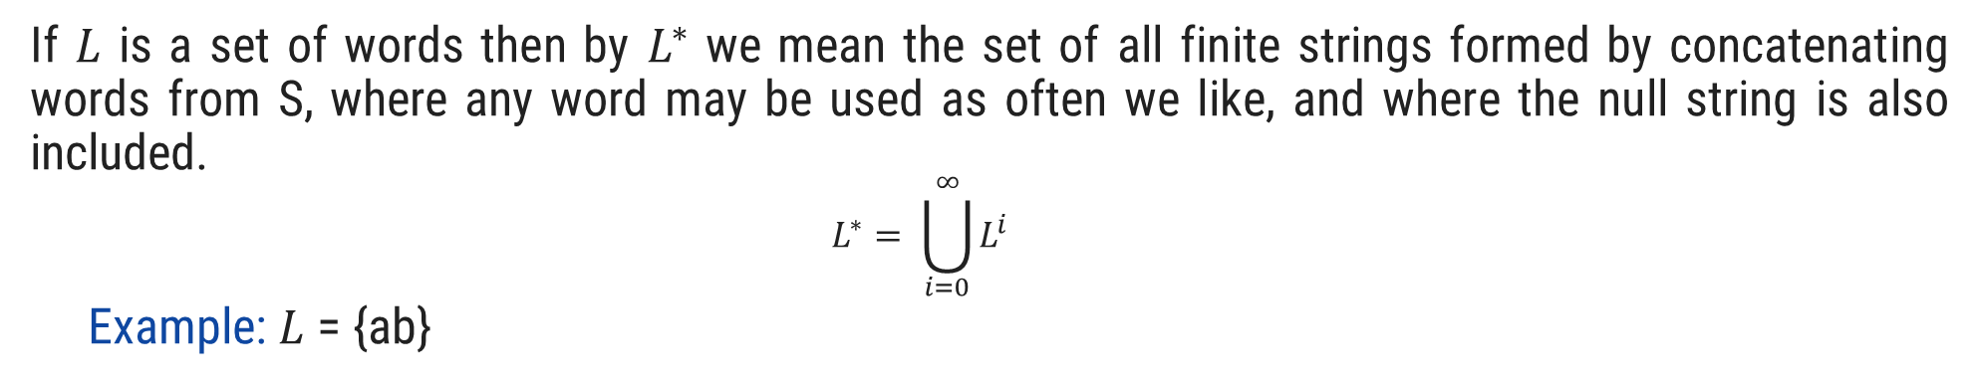
Operations over Language
Operations over the language are:
Concatenation
Union
* (Kleene closure)
+ (Positive closure)
If $L$ is a set of words then by $L^{∗}$ we mean the set of all finite strings formed by concatenating words from S, where any word may be used as often we like, and where the null string is also included.
$$L^{∗}= \bigcup_{i=0}^{∞}{L^{i}}$$
Example: $L$ = {ab}
$L$* = {^, ab, abab, ababab, abababab, ….}

Slide 9


Operations over Language
Operations over the language are:
Concatenation
Union
* (Kleene closure)
+ (Positive closure)
If $L$ is a set of words then by $L^{+}$ we mean the set of all finite strings formed by concatenating words from L, where any word may be used as often we like, and where the null string is not included.
$$L^{+}= \bigcup_{i=1}^{∞}{L^{i}}$$
Example:$L$ = {ab}
$L^{+}$ = {ab, abab, ababab, abababab, ….}

Slide 10
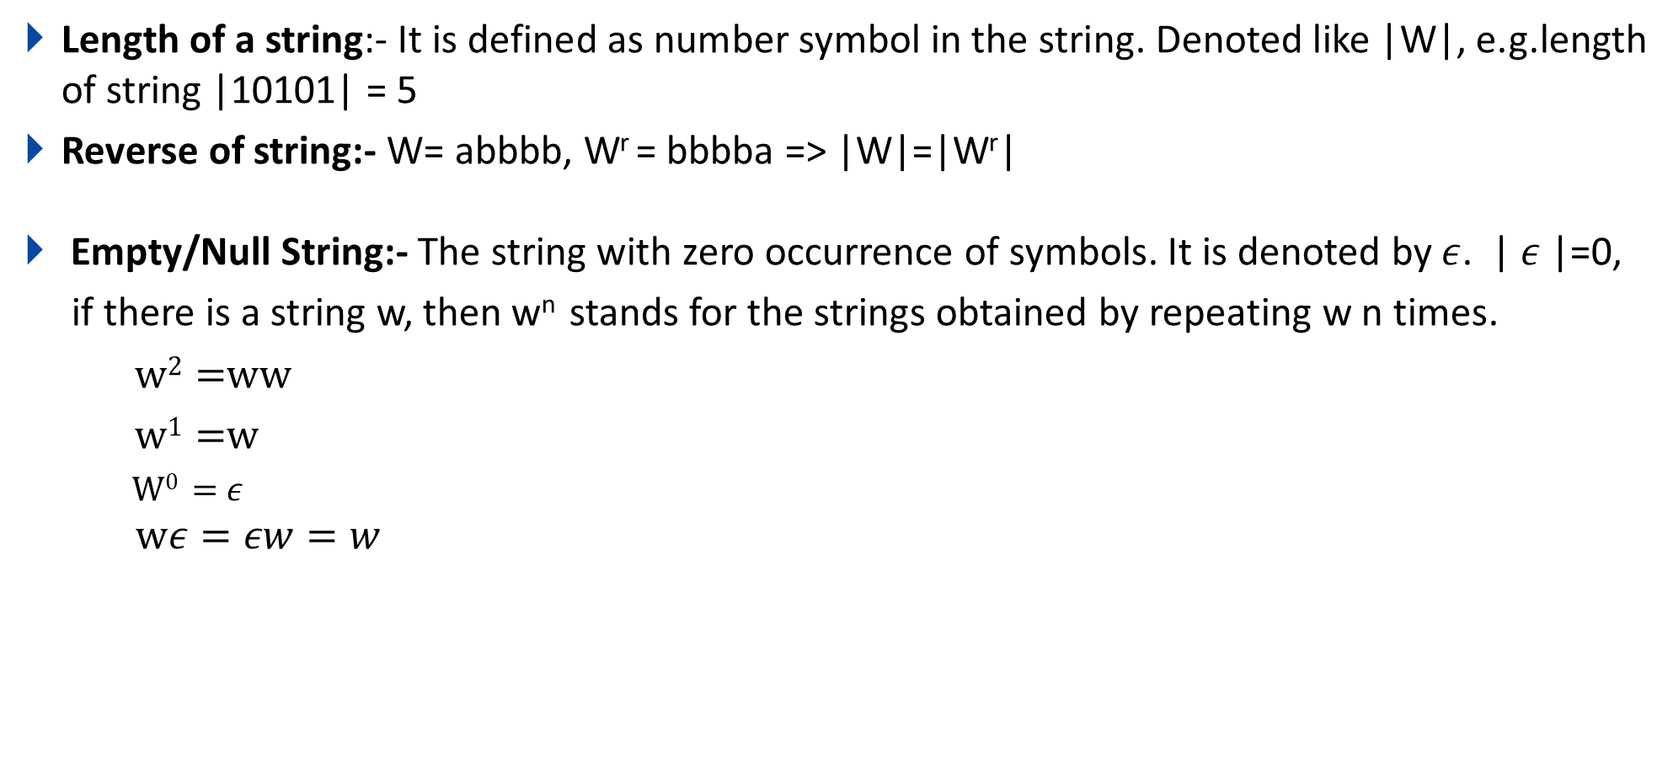
Some Basic operations on string
Length of a string:- It is defined as number symbol in the string. Denoted like |W|, e.g.length of string |10101| = 5
Reverse of string:- W= abbbb, W^{r} = bbbba => |W|=|W^{r}|
Empty/Null String:- The string with zero occurrence of symbols. It is denoted by $ε$. | $ε$|=0,
if there is a string w, then w^{n} stands for the strings obtained by repeating w n times.
w² =ww
w¹ =w
W⁰ = $ε$
$$wε=εw=w$$

Slide 11
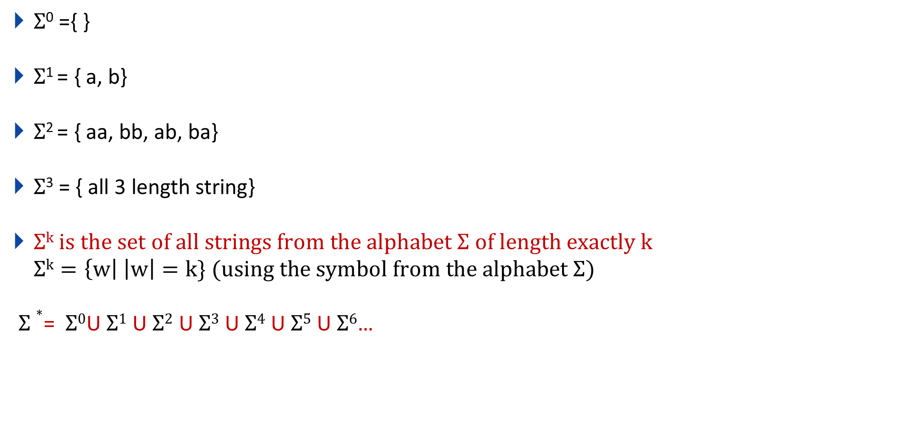
Q. If $Σ$={a,b} then, find the following?
$Σ$⁰ ={ }
$Σ$¹ = { a, b}
$Σ$² = { aa, bb, ab, ba}
$Σ$³ = { all 3 length string}
$Σk is the set of all strings from the alphabet Σ of length exactly k$
$$Σk=\left\{w\right| \left|w\right|=k\} (using the symbol from the alphabet Σ)$$
$Σ∗$= $Σ0$U$Σ1$ U$Σ2$ U$Σ3$ U$Σ4$ U$Σ5$ U$Σ6$…

Slide 12
Regular Expression

Slide 13
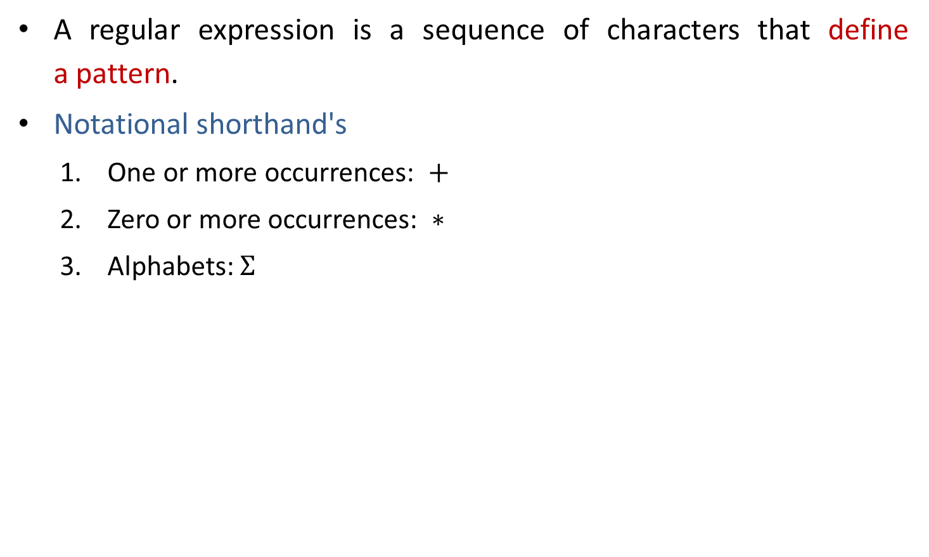
Regular expression
A regular expression is a sequence of characters that define a pattern.
Notational shorthand's
One or more occurrences: $+$
Zero or more occurrences: $∗$
Alphabets: $Σ$

Slide 14
Regular expression
a*
L = Zero or More Occurrences of a =
*
𝜖
a
aa
aaa
Infinite …..
aaaa
aaaaa…..

Slide 15
Regular expression
a⁺
L = One or More Occurrences of a =
+
a
aa
aaa
Infinite …..
aaaa
aaaaa…..

Slide 16
Precedence and associativity of operators
Operator | Precedence | Associative
Kleene * | 1 | left
Concatenation | 2 | left
Union | or + | 3 | left

Slide 17
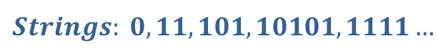
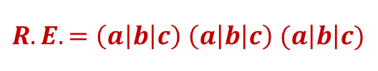



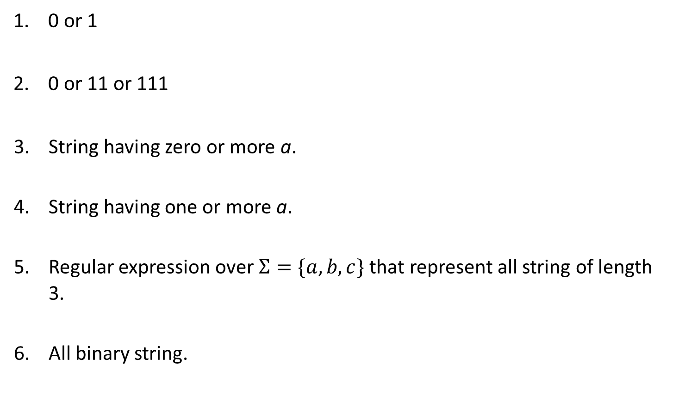



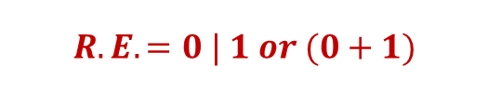

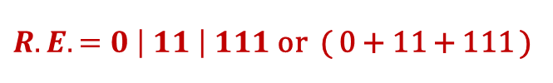

Regular expression examples
0 or 1
0 or 11 or 111
String having zero or more a.
String having one or more a.
Regular expression over $Σ=\{a,b,c\}$ that represent all string of length 3.
All binary string.
$$Strings: 0, 1$$
$$R.E. =0 | 1 or (0+1)$$
$$Strings: 0, 11, 111$$
$R.E. =0 \left| 11 \right| 111$ or ( 0 + 11 + 111 )
$$Strings: ε,a, aa, aaa, aaaa…..$$
$$R.E. =a∗$$
$$Strings:a, aa, aaa, aaaa…..$$
$$R.E. =a+$$
$$Strings:abc, bca, bbb, cab, aba….$$
$$R.E. =\left(a\left|b\right|c\right) \left(a\left|b\right|c\right) (a\left|b\right|c)$$
$$Strings: 0, 11, 101, 10101, 1111…$$
$$R.E. =(0 | 1)+$$

Slide 18

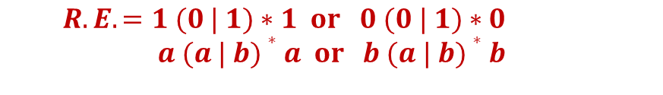







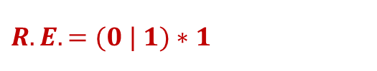

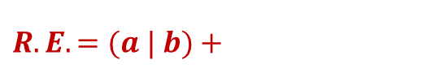
Regular expression examples
0 or more occurrence of either a or b or both
1 or more occurrence of either a or b or both
Binary no. ends with 0
Binary no. ends with 1
Binary no. starts and ends with 1
String starts and ends with same character
$$Strings:ε,a, aa, abab, bab…$$
$$R.E. =(a | b)∗$$
$$Strings:a, aa, abab, bab, bbbaaa…$$
$$R.E. =(a | b)+$$
$$Strings: 0, 10, 100, 1010, 11110…$$
$R.E. =(0 | 1)∗$ $0$
$$Strings:1, 101, 1001, 10101, …$$
$$R.E. =(0 | 1)∗1$$
$$Strings: 11, 101, 1001, 10101, …$$
$R.E. =1 (0 | 1)∗$ $1| 1$
$$Strings:00, 101, aba, baab…$$
$$R.E. =1 (0 | 1)∗1 or 0 (0 | 1)∗0$$
$$a (a | b)∗a or b (a | b)∗b$$

Slide 19




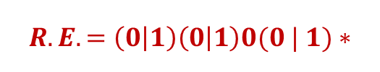
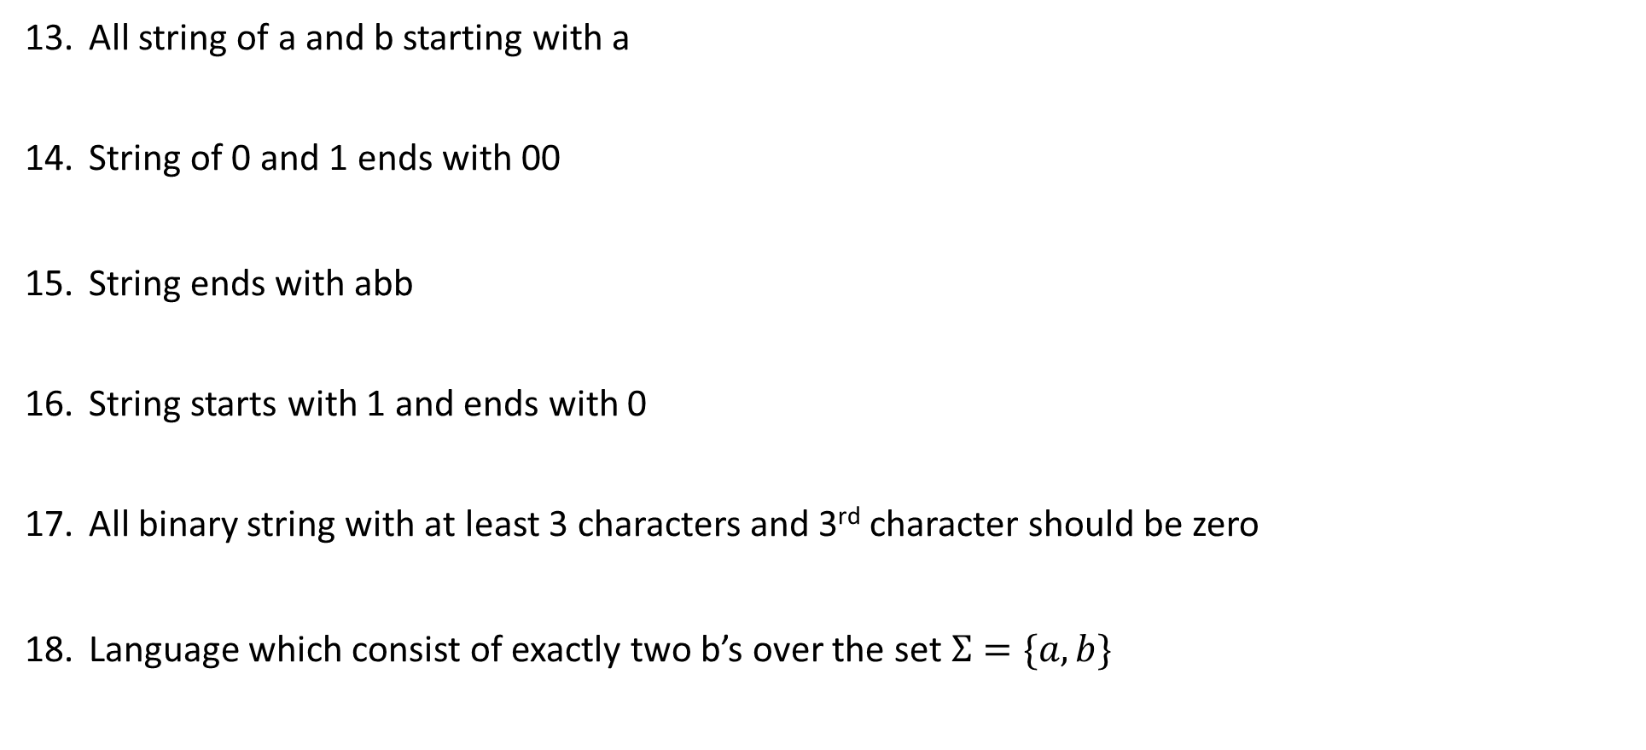





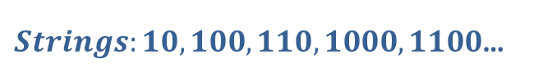

Regular expression examples
All string of a and b starting with a
String of 0 and 1 ends with 00
String ends with abb
String starts with 1 and ends with 0
All binary string with at least 3 characters and 3rd character should be zero
Language which consist of exactly two b’s over the set $Σ=\{a,b\}$
$Strings:a,ab,aab,abb$…
$$R.E. =a(a | b)∗$$
$Strings:00,100,000,1000,1100$…
$$R.E. =(0 | 1)∗00$$
$Strings:abb,babb, ababb$…
$$R.E. =(a | b)∗abb$$
$Strings:10,100,110,1000,1100$…
$$R.E. =1(0 | 1)∗0$$
$Strings:000,100,1100,1001$…
$$R.E. =\left(0 | 1\right)\left(0 | 1\right)0(0 | 1)∗$$
$Strings:bb,bab,aabb,abba$…
$$R.E. =a∗b a∗b a∗$$

Slide 20
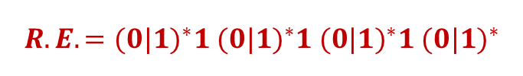
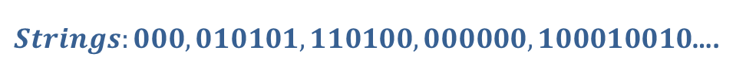


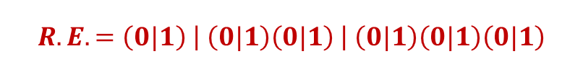
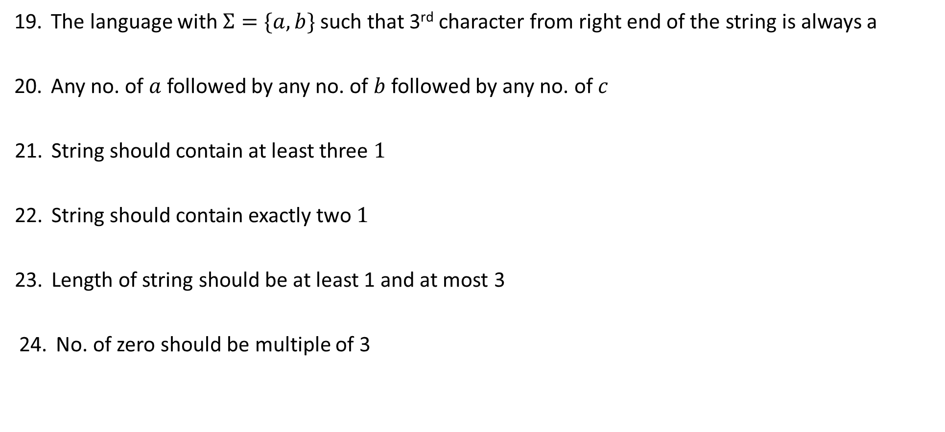




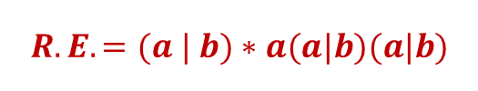


Regular expression examples
The language with $Σ=\{a,b\}$ such that 3rd character from right end of the string is always a
Any no. of $a$ followed by any no. of $b$ followed by any no. of $c$
String should contain at least three $1$
String should contain exactly two $1$
Length of string should be at least 1 and at most 3
No. of zero should be multiple of 3
$Strings:aaa,aba,aaba,abb$…
$$R.E. =(a | b)∗a(a|b)(a|b)$$
$Strings:ε,abc,aabbcc,aabc,abb$…
$$R.E. =a∗b∗c∗$$
$Strings:111,01101,0101110$….
$$R.E. ={(0|1)}^{∗}1{ (0|1)}^{∗}1{ (0|1)}^{∗}1 {(0|1)}^{∗}$$
$Strings:11,0101,1100,010010,100100$….
$$R.E. =0^{∗}10^{∗}10^{∗}$$
$Strings:0,1,11,01,111,010,100$….
$$R.E. =\left(0|1\right) \left| \left(0|1\right)\left(0|1\right) \right| \left(0|1\right)\left(0|1\right)\left(0|1\right)$$
$Strings:000,010101,110100,000000,100010010$….
$$R.E. ={(1^{∗}01^{∗}01^{∗}01^{∗})}^{∗}$$

Slide 21





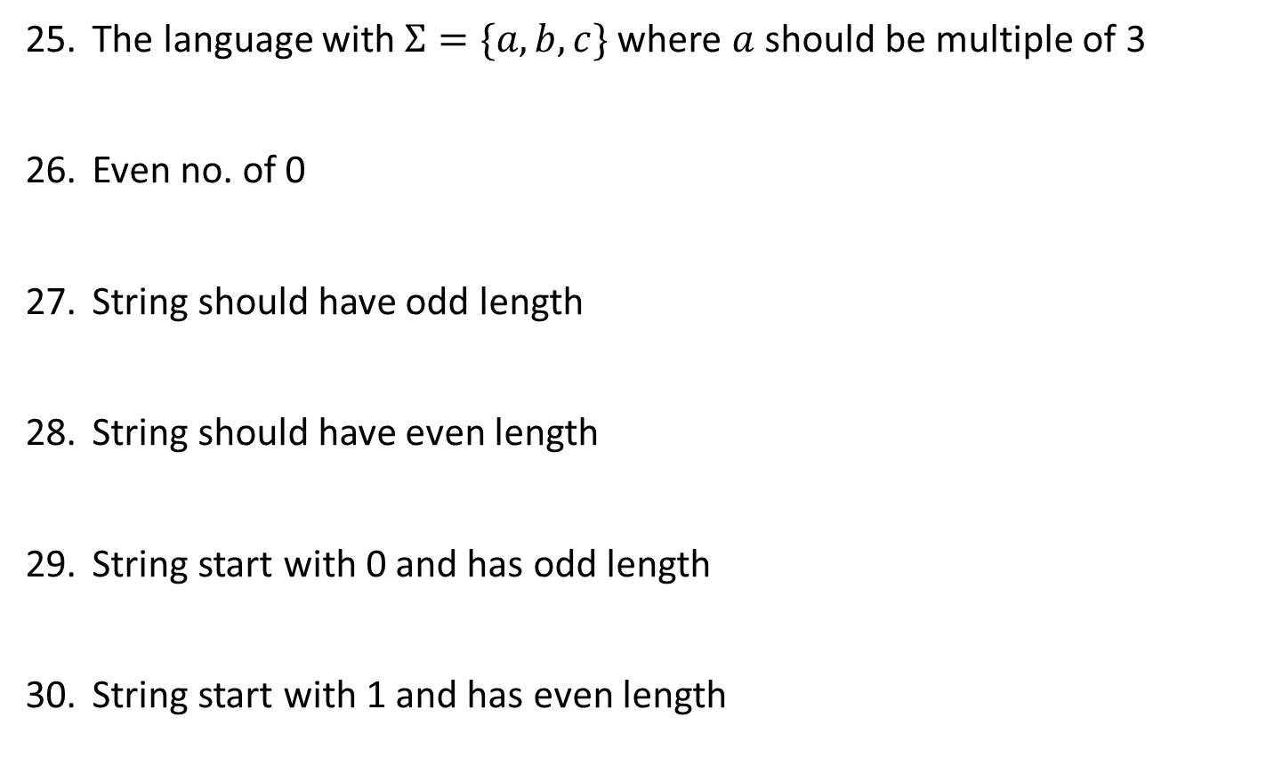




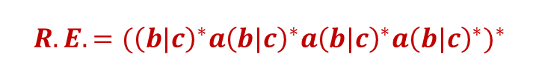


Regular expression examples
The language with $Σ=\{a,b,c\}$ where $a$ should be multiple of 3
Even no. of 0
String should have odd length
String should have even length
String start with 0 and has odd length
String start with 1 and has even length
$$Strings:aaa, baaa,bacaba,aaaaaa..$$
$$R.E. ={({\left(b|c\right)}^{∗}a{\left(b|c\right)}^{∗}a{\left(b|c\right)}^{∗}a{\left(b|c\right)}^{∗})}^{∗}$$
$Strings:00,0101,0000,100100$….
$$R.E. ={(1^{∗}01^{∗}01^{∗})}^{∗}$$
$Strings:0,010,110,000,10010$….
$$R.E. ={\left(0|1\right) (\left(0 | 1\right)(0|1))}^{∗}$$
$Strings:00,0101,0000,100100$….
$$R.E. ={ (\left(0 | 1\right)(0|1))}^{∗}$$
$Strings:0,010,010,000,00010$….
$$R.E. ={\left(0\right) (\left(0 | 1\right)(0|1))}^{∗}$$
$Strings:10,1100,1000,100100$….
$$R.E. ={ 1(0|1)(\left(0 | 1\right)(0|1))}^{∗}$$

Slide 22

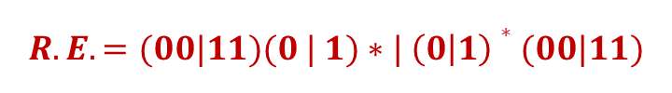


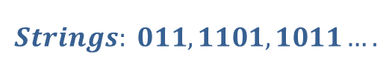


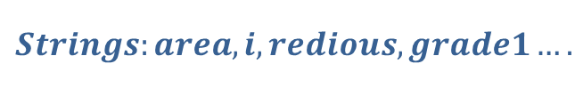
Regular expression examples
All string begins or ends with 00 or 11
Language of all string containing both 11 and 00 as substring
String ending with 1 and not contain 00
Language of C identifier
$$Strings: 00101, 10100,110,01011…$$
$$R.E. =(00|11)(0 | 1)∗| \left(0 | 1\right)∗(00|11)$$
$$Strings: 0011, 1100,100110,010011…$$
$$R.E. ={((0|1)}^{∗}00{(0|1)}^{∗}11{(0|1)}^{∗}) |{ ((0|1)}^{∗}11{(0|1)}^{∗}00{(0|1)}^{∗})$$
$$Strings: 011, 1101,1011….$$
$$R.E. =\left(1 | 01\right)+$$
$$Strings:area, i, redious, grade1….$$
$$R.E. ={(_+L)(_ + L +D)}^{∗}$$
$$where L is Letter \& D is digit$$

Slide 23
Finite Automata

Slide 24
Finite Automata
Finite Automata(FA) is the simplest machine to recognize patterns.
The finite automata or finite state machine is an abstract machine that has five elements or tuples.
It has a set of states and rules for moving from one state to another but it depends upon the applied input symbol. Basically, it is an abstract model of a digital computer.
Types of Finite Automata:
Language Recognizer (Compiler)
DFA
NFA
Output Generator (Digital circuit)
Mealy Machine
Moore Machine

Slide 25
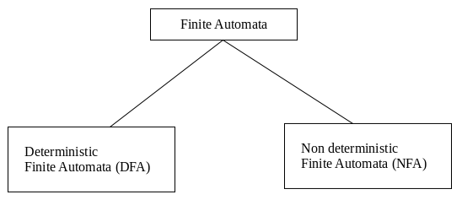
Types of Finite Automata:
DFA: Deterministic refers to the uniqueness of the computation. In a DFA, for a particular input character, the machine goes to one state only. A transition function is defined on every state for every input symbol. DFA does not accept the null move.
NFA: NFA stands for non-deterministic finite automata. It is used to transmit any number of states for a particular input. It can accept the null move. i.e. it can move forward without reading any input.

Slide 26
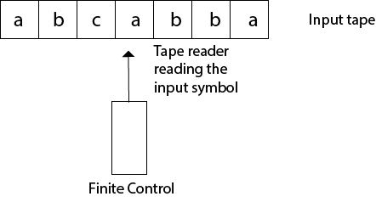
Finite Automata Model:
Finite automata can be represented by input tape and finite control.
Input tape: It is a linear tape having some number of cells. Each input symbol is placed in each cell.
Finite control: The finite control decides the next state on receiving particular input from input tape. The tape reader reads the cells one by one from left to right, and at a time only one input symbol is read.

Slide 27
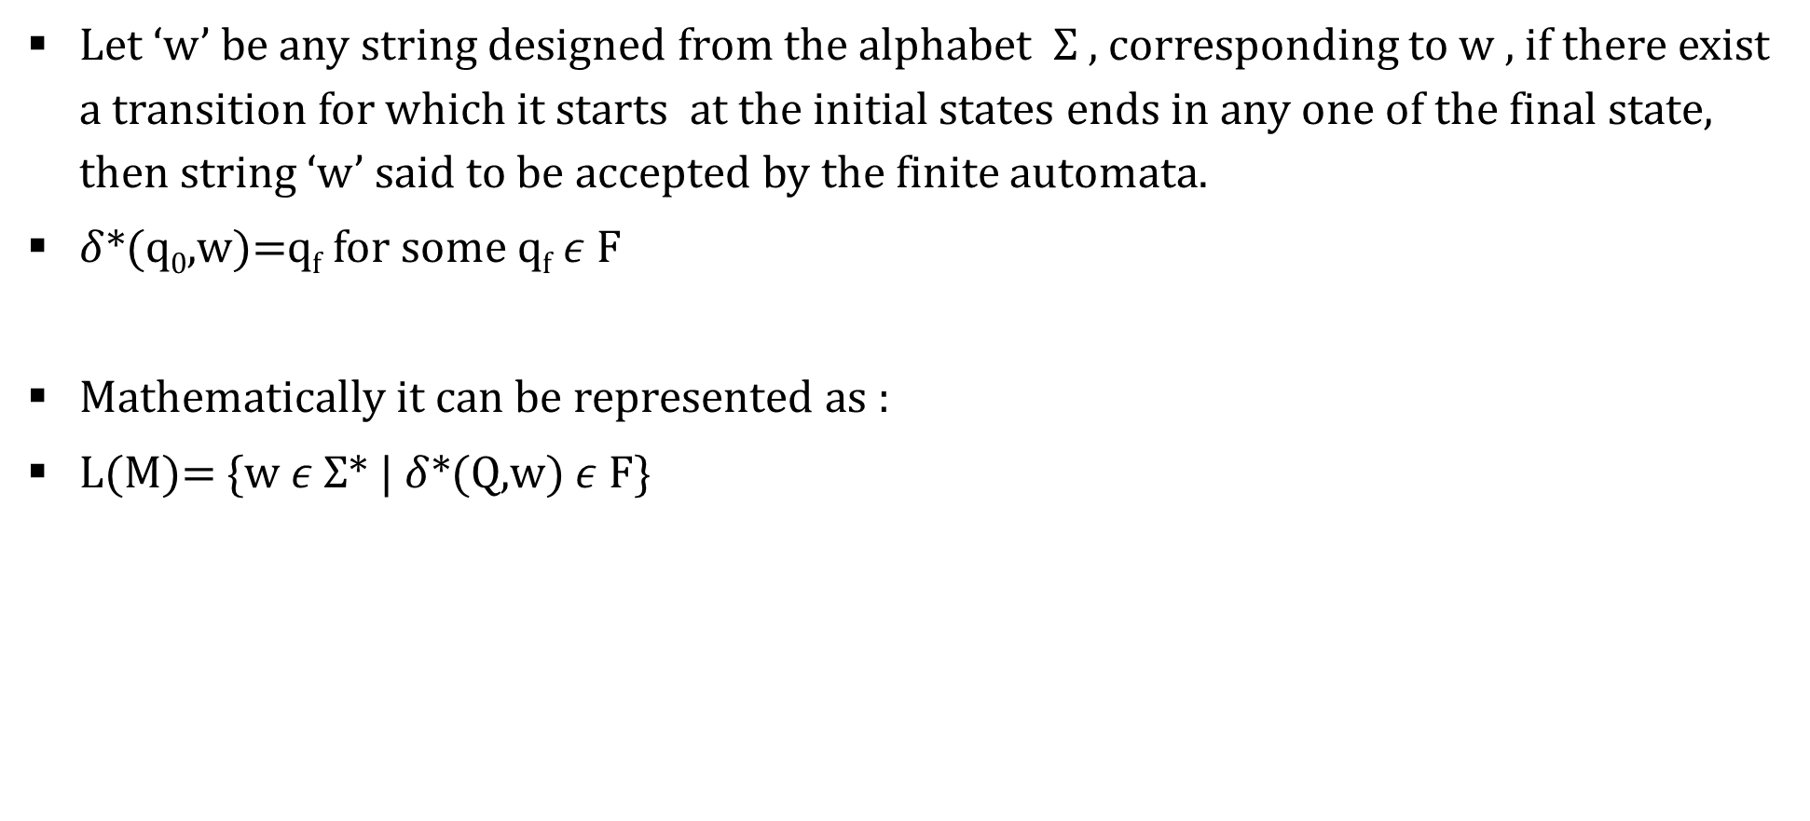
Acceptance by DFA
Let ‘w’ be any string designed from the alphabet $Σ$ , corresponding to w , if there exist a transition for which it starts at the initial states ends in any one of the final state, then string ‘w’ said to be accepted by the finite automata.
$δ$*(q₀,w)=q_{f} for some q_{f} $ε$ F
Mathematically it can be represented as :
L(M)= {w $ε$ $Σ$* | $δ$*(Q,w) $ε$ F}

Slide 28
Applications of DFA
Lexical analysis phase of a compiler.
Design of digital circuit.
String matching.
Communication Protocol for information exchange.

Slide 29
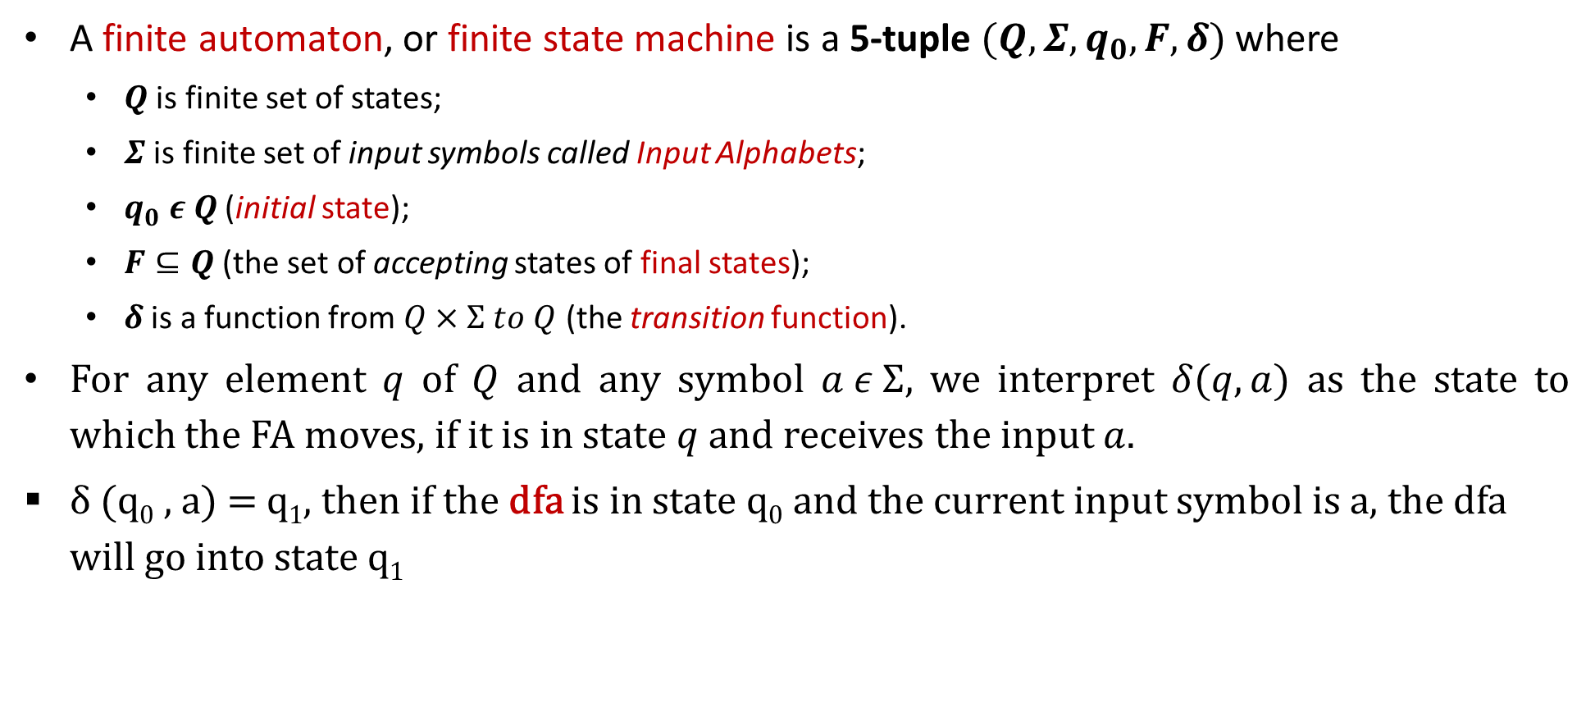
Deterministic Finite Automata
A finite automaton, or finite state machine is a 5-tuple $(Q,Σ,q_{0},F,δ)$ where
$Q$ is finite set of states;
$Σ$ is finite set of input symbols called Input Alphabets;
$q_{0} ε Q$ (initial state);
$F⊆Q$ (the set of accepting states of final states);
$δ$ is a function from $Q×Σ to Q$ (the transition function).
For any element $q$ of $Q$ and any symbol $a ε Σ$, we interpret $δ(q,a)$ as the state to which the FA moves, if it is in state $q$ and receives the input $a$.
δ (q₀ , a) = q₁, then if the dfa is in state q₀ and the current input symbol is a, the dfa will go into state q₁

Slide 30

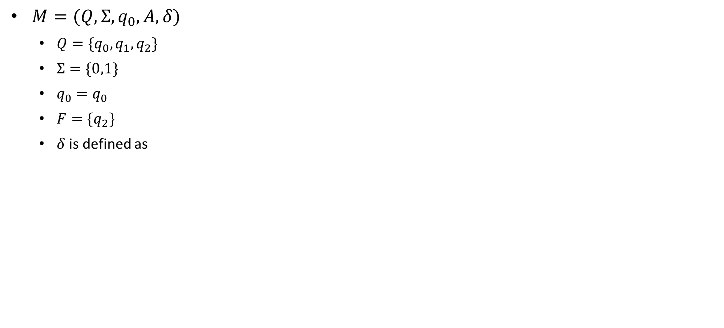
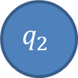
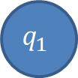
Example: Finite Automata
$M=(Q,Σ,q_{0},A,δ)$
$Q=\{q_{0},q_{1},q_{2}\}$
$Σ=\{0,1\}$
$q_{0}=q_{0}$
$F=\{q_{2}\}$
$δ$ is defined as
Transition Table
δ | Input
State | $$0$$ | $$1$$
$$q_{0}$$ | $$q_{1}$$ | $$q_{0}$$
$$q_{1}$$ | $$q_{2}$$ | $$q_{0}$$
$$q_{2}$$ | $$q_{2}$$ | $$q_{0}$$
1
1
0
$$q_{0}$$
0
$$q_{1}$$
0
$$q_{2}$$
1
Why we are changing state, because FA does not have their own memory. So to remember the input we need to change the state.
Transition State Diagram

Slide 31
Minimum states
Calculate the length of substring.
All strings ending with ‘n’ length substring will always require minimum (n+1) states in the DFA.
All strings starting with ‘n’ length substring will always require minimum (n+2) states in the DFA.

Slide 32
Problem types
Staring with w
Ending with w
w as sub string
w with |w|=2 or 3 or n

Slide 33
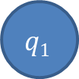
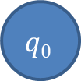
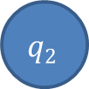
DFA Example: ending with w
The strings ending with 10.
0
1
0
$$q0$$
1
$$q1$$
$$q2$$
1
0

Slide 34
DFA Example: ending with w
The string ending in 10 or 11
1
C
0
1
A
1
B
0
0
1
D
0

Slide 35
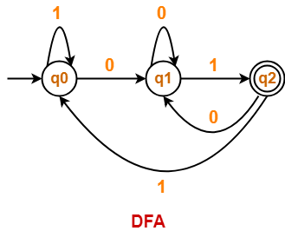
DFA Example: ending with w
Draw a DFA for the language accepting strings ending with ’01’ over input alphabets ∑ = {0, 1}
Regular expression for the given language = (0 + 1)*01
Minimum length=2
Minimum number of states required in the DFA = 2 + 1 = 3.

Slide 36
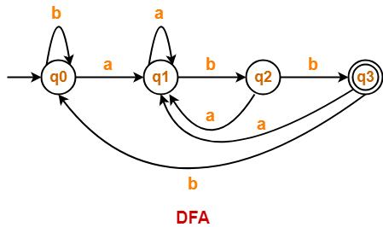
DFA Example: ending with w
Draw a DFA for the language accepting strings ending with ‘abb’ over input alphabets ∑ = {a, b}
Regular expression for the given language = (a + b)*abb
Minimum number of states required in the DFA = 3 + 1 = 4.

Slide 37
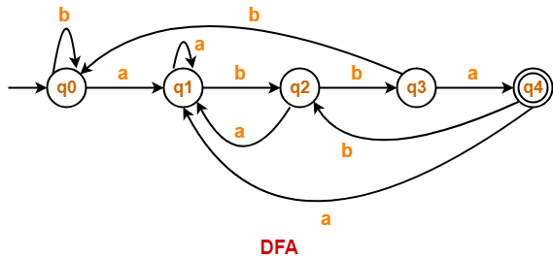
DFA Example: ending with w
Draw a DFA for the language accepting strings ending with ‘abba’ over input alphabets ∑ = {a, b}
Regular expression for the given language = (a + b)*abba
Minimum number of states required in the DFA = 4 + 1 = 5.

Slide 38
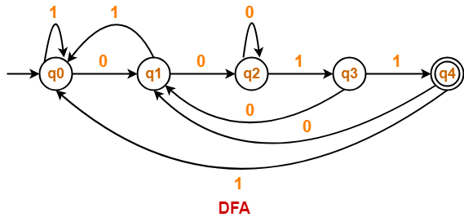
DFA Example: ending with w
Draw a DFA for the language accepting strings ending with ‘0011’ over input alphabets ∑ = {0, 1}
Regular expression for the given language = (0 + 1)*0011
Minimum number of states required in the DFA = 4 + 1 = 5

Slide 39
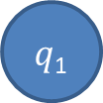


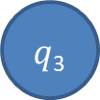

DFA Examples: ends with w
Draw a DFA that accepts a language L over input alphabets ∑ = {a, b} such that L is the set of all strings have last two symbols are same.
Regular expression for the given language = (a + b)*bb + (a + b)*aa
L={aa, bb, aaa, abb, baa, bbb, ….}
a
$q$₁
a
$q$₃
a
b
$$q0$$
b
a
a
b
$q$₂
$$q4$$
b
b
Draw a DFA that accepts a language L over input alphabets ∑ = {a, b} such that L is the set of all strings have last two symbols are different?.

Slide 40
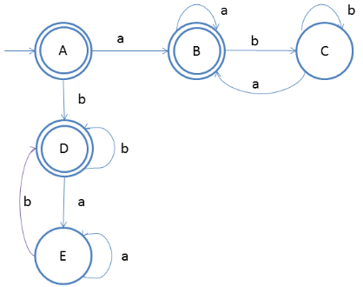
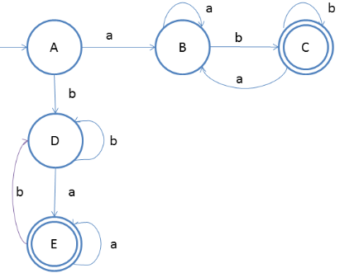
DFA Examples: ends with w
Draw a DFA that accepts a language L over input alphabets ∑ = {a, b} such that L is the set of all strings that
Starts and ends with same symbol.
L={ε, a, b, aa, bb, aba, bab, ababa, aabba, aaabbba,...}
Starts and ends with different symbol.
L = {ab, ab, abab, aabb, aaabbb,...}

Slide 41
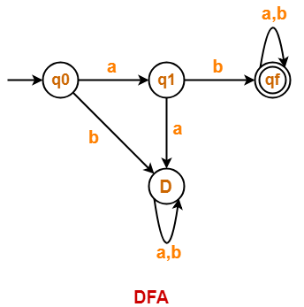
DFA Examples: starting with w
Draw a DFA for the language accepting strings starting with ‘ab’ over input alphabets ∑ = {a, b}
Regular expression for the given language = ab(a + b)*
Minimum number of states required in the DFA = 2 + 2 = 4.

Slide 42
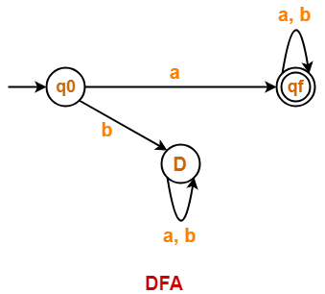
DFA Examples: starting with w
Draw a DFA for the language accepting strings starting with ‘a’ over input alphabets ∑ = {a, b}
Regular expression for the given language = a(a + b)*
Minimum number of states required in the DFA = 1 + 2 = 3.
We will construct DFA for the following strings-
a
aa

Slide 43

DFA Examples: starting with w
Draw a DFA for the language accepting strings starting with ‘101’ over input alphabets ∑ = {0, 1}
Regular expression for the given language = 101(0 + 1)*
Minimum number of states required in the DFA = 3 + 2 = 5
We will construct DFA for the following strings-
101
1011
10110
101101

Slide 44

DFA Examples: starting with w
Draw a DFA that accepts a language L over input alphabets ∑ = {0, 1} such that L is the set of all strings starting with ’00’.
Regular expression for the given language = 00(0 + 1)*
Minimum number of states required in the DFA = 2 + 2 = 4
We will construct DFA for the following strings-
00
000
00000

Slide 45

DFA Examples: starting with w
Construct a DFA that accepts a language L over input alphabets ∑ = {a, b} such that L is the set of all strings starting with ‘aa’ or ‘bb’.{initial two letter are same}
Regular expression for the given language = (aa + bb)(a + b)*
Minimum number of states required in the DFA = 5.
We will construct DFA for the following strings-
aa
aaa
aaaa
bb
bbb
bbbb

Slide 46

DFA Examples: starting with w
Construct a DFA that accepts a language L over input alphabets ∑ = {a, b} such that L is the set of all strings starting with ‘aba’.
Regular expression for the given language = aba(a + b)*
Minimum number of states required in the DFA = 3 + 2 = 5.
We will construct DFA for the following strings-
aba
abaa
abaab
abaaba

Slide 47


DFA Examples: in between
The string with next to last symbol as 0.
0
1
$$q2$$
0
$$q0$$
0
$$q1$$
1
1
$$q3$$
0
1

Slide 48
DFA Examples: starts and ends with
The string corresponding to Regular expression {00}*{11}*
0,1
B
1
D
0
0
0
0
1
A
1
C
E
1

Slide 49
DFA Examples: starts and ends with
(a+b)*baaa
b
a
B
a
b
A
b
C
b
b
a
a
E
a
D

Slide 50




DFA Examples: starts and ends with
Draw a DFA that accepts a language L over input alphabets ∑ = {a, b} such that L is the set of all strings that starts with a and ends with b.
Regular expression for the given language = a(a + b)*b
L={ab, aab, abb, aabb, abab, ….}
a
b
$$q0$$
a
$q$₁
b
$q$₂
a
b
$q$₃
a, b

Slide 51


DFA Examples: starts and ends with
All strings over {0, 1} that begin or end with 111
All strings over {0, 1} that begin and end with 111

Slide 52



DFA Examples: of length w
Construct a DFA which accepts set of all strings over Σ={a,b} of length 2 , L = {aa, ab, ba, bb}
Construct a DFA which accepts set of all strings over Σ={a,b} of length ≥2
Construct a DFA which accepts set of all strings over Σ={a,b} of length ≤2

Slide 53






DFA Examples: of length w
Construct a DFA which accepts set of all strings over Σ={a, b} such that every string accepts must |w|=2 mod 3.
|w|=3 mod 4..?
|w|=2 mod 3
|w|_{b}=2 mod 3 (number of b should give 2 as remainder by 3)
a
a
a, b
$$q0$$
b
$$q1$$
$$q0$$
$$q1$$
a, b
b
b
a, b
$$q2$$
$$q2$$
a

Slide 54





DFA Examples: of length w
Construct a DFA which accepts set of all strings over Σ={a, b} such that every string starting with ab and must |w|=2 mod 3.(merge two DFA)
$$q6$$
a, b
a, b
$$q0$$
a
$$q1$$
b
$$q3$$
a, b
$$q4$$
a, b
$$q5$$
a
a
$$q2$$
a, b

Slide 55
DFA Examples: even or odd occurrence
The string with number of 0’s and number of 1’s are even
The string with number of 0’s and number of 1’s are odd ?
1
odd 0 odd 1
odd 0 even 1
1
0
0
0
0
1
odd 1 even 0
even 1 even 0
1

Slide 56
Design…
First design two separate machines for the two conditions:
Accepting only even number of 0’s
Accepting only even number of 1’s
Merge these two and then find the required final states.
To merge these two machines, we will take the Cartesian product of the states of these two machines:
Initial state of these DFA will be the state which contains the initial states of those two separate machines.

Slide 57








The string with number of 0’s and number of 1’s are even L={^, 00, 11, 0011, 1100, 0101, 1010, 1001, 0110….}
Accepting only even no of 1 Accepting only even no of 0
we will take the Cartesian product of the states of these two machines
{q₀,q₁} and {q₂,q₃} => {(q₀q₂),(q₀q₃),(q₁q₂),(q₁q₃)}
0
0
1
1
1
0
$$q0$$
1
$$q1$$
$q$₂
0
$q$₃
Initial state: group of state from both machine
Final state: group that contain at both final state from the machine
i.e. q₀ and q₂ together
$$q02$$
$q0$₃
0
0
1
1
1
1
0
$$q12$$
$q$₁₃
0

Slide 58
The string with number of 0’s or number of 1’s are even L={^, 00, 11, 0011, 1100, 0101, 1010, 1001, 0110….}
Accepting only even no of 1 Accepting only even no of 0
we will take the Cartesian product of the states of these two machines
{q₀,q₁} and {q₂,q₃} => {(q₀q₂),(q₀q₃),(q₁q₂),(q₁q₃)}
0
0
1
1
1
0
$$q0$$
1
$$q1$$
$q$₂
0
$q$₃
Initial state: Where initial state of both machine comes together.
Final state: final state of contain either q₀ or q₂
{all the state which have either q_{o} or q₂}
$$q02$$
$q0$₃
0
0
1
1
1
1
0
$$q12$$
$q$₁₃
0

Slide 59
DFA Examples: even or odd occurrence
Design the following machine
The string with number of 0’s and number of 1’s are even
The string with number of 0’s or number of 1’s are even
The string with odd number of 0’s or even number of 1’s
The string with odd number of 0’s and even number of 1’s

Slide 60



DFA Examples: divisible by
Draw a DFA that accepts a language L over input alphabets ∑ = {0, 1} such that L is the set of all binary number divisible by 3.
Create state for remainders i.e. {0, 1, 2} and then generate any number and try to end up to its remainder state.
0
1
$$q0$$
1
$q$₁
0
$q$₂
1
0
Draw a DFA that accepts a language L over input alphabets ∑ = {0, 1} such that L is the set of all binary number divisible by 4?

Slide 61
DFA Examples: divisible by
DFA divisible by 3
DFA divisible by 4
DFA divisible by 5
Short trick:
Identify the total number of state, if number is divisible by n, total state=n
Create transition table, name the input alphabet in the column
Start filling the state in circular order from left to right to top to bottom.

Slide 62
DFA Examples: divisible by
Divisible by 4
Number of state 4={q0, q1, q2, q3}
Start with q0 and start filling in column 0 and 1 in circular order.
The same logic will work for any number i.e. binary, octal, hexadecimal..
State | 0 | 1
q0 | q0 | q1
q1 | q2 | q3
q2 | q0 | q1
q3 | q2 | q3

Slide 63
DFA divisible by (n₁ and n₂) (n₁ or n₂) (n₁ not n₂) (nor n₁ or nor n₂)
Number of state= LCM(n₁ , n₂)
Initial state remain same
Final state will be based on the operation
Ex.
2 and 3 : no of state = 6, final state: {0,2,4} ∩{0, 3} = {0}
2 or 3 : no of state = 6, final state: {0,2,4} U {0, 3} = {0,2,3,4}
2 not 3: no of state = 6, final state: {0,2,4} – {0,3} = {2,4}
3 not 2: no of state= 6, final state: {0,3}-{0,2,4}
nor 2 nor 3: no of state=6, final state:{U}-{2 or 3}=>{0,1,2,3,4,5}-{0,2,3,4} = {1,5}

Slide 64
DFA Examples: divisible by
Construct the DFA that accepts all octal number which are divisible by 6 but not by 8
Number of state LCM(6,8)=24
Find the number of state of DFA that accepts all hexadecimal number 3 or 5 but not by 7
Number of state LCM(3,5,7)=105
The DFA that accepts all number of base m are divisible by n, requires n no. of state.
( )_{m}= divisible by n =n state required

Slide 65



DFA Examples: Substring
Construct DFA that accepts 01 as substring over the alphabet {0,1}
Construct DFA that accepts 001 as substring over the alphabet {0,1}
Construct DFA that accepts 0101 as substring over the alphabet {0,1}

Slide 66
DFA Examples: sub string
Construct DFA that accepts 111 as substring over the alphabet {0,1}
Construct DFA that accepts 000 or 111 as substring over the alphabet {0,1}
n length substring requires n+1 state in DFA
There will be no dead state in DFA consisting of substring
Finite language does not have state consist of self loop

Slide 67







DFA Example:
0, 1
$$q0$$
0,1
$q$₁
0,1
$q$₂
0,1
DFA length of the string is atleast 3.
DFA where 3rd input symbol from the left is a
DFA where 2nd input symbol from the right is a
L={ab, aa, aab, bab. baaa..}
$q$₃
b
b
a
$$q0$$
a
$q$₁
b
$q$₂
a
b
$q$₃
a

Slide 68
DFA Example
Minimal DFA for the language
L={a^{n}b^{n} | n >=1}
L={a^{m}b^{n} | m, n >1}
L={ab, aab, abb, aabb,…..}
L={a^{m}b^{n} | m, n >=0}
L={^, ab, aba, aab…}
L={a^{2n} | n >=1}
L={aa, aaaa, aaaaaa,…}
L={a^{3n} | n >=1}

Slide 69



Complement of DFA
$Suppose a DFA that is defined by M=(Q,Σ,q_{0},F,δ)$ and it accepts the language L₁. Then DFA that accepts the language L₂ where L₂ = L’₁ => Σ*- L₁ will be defined as
$M′=(Q,Σ,q_{0},Q−F,δ)$
The complement of a DFA can be obtained by making the non-final states as final states and vice-versa. The language accepted by the complemented DFA L₂ is the complement of the language L₁. (Warning! This is not true for NFA’s)
Example 1:
L1: set of all strings over {a, b} of even length
L1 = {$∈$, ab, aa, abaa, aaba, ....}
L2: set of all strings over {a, b} of odd length
L2 = { a, b, aab, aaa, bba, bbb, ...}

Slide 70



Example-2: L₁: set of all strings over {a, b} starting with ‘a’.
L1 ={ a, ab, aa, aba, aaa, aab, ..}
L2: set of all strings over {a, b} not starting with ‘a’.
L2 ={$∈$, b, ba, bb, bab, baa, bba, ...}

Slide 71


Create a DFA that does not accept contain substring aa.
Create a DFA that accepts all the string over a and b where number of b is divisible by 3.

Slide 72
Decision properties of FA
Decidable problem: A problem p is said to be decidable if there exist some generalized algorithm to solve problem.
Undecidable problem: A problem p is said to be undecidable if there is no generalized algorithm to solve problem.
Decision properties:
Emptiness problem
Finiteness problem
Equivalence problem
Membership problem

Slide 73

a) Emptiness Problem
The emptiness problem in Finite Automata is to decide whether the given automata are accepting empty language or not.
There is an Algorithm available to check the emptiness of Finite Automata.
Step 1: Select those states which are not reachable from the initial state, delete those states and transitions. Using DFS or BFS.
Step 2: In the remaining Finite Automata, if at least one final state then it is accepting non-empty language otherwise empty language.
Conclusion: The emptiness problem of finite automata is decidable and decision problem.

Slide 74


b) Finiteness Problem
The finiteness problem in Finite Automata is to decide whether the given automata is accepting finite language or infinite language.
There is an Algorithm available to check the finiteness of Finite Automata.
Step 1: Select those states which are not reachable from the initial state, delete those states and transitions. Using DFS.
Step 2: In the remaining Finite Automata, if any state from which we cannot reach the final state, delete those states and transitions.
Step 3: In the remaining Finite Automata, if at least one cycle is available then it is accepting infinite language otherwise finite language.
Conclusion: The finiteness problem of finite automata is decidable and decision problem.

Slide 75
c) Equivalence Problem
The equivalence problem in Finite Automata is to decide whether the given two automata are accepting the same language or not.
There is an Algorithm available to check the equivalence of given two Finite Automata.
Step 1: Create a transition table for given FAs.
Step 2: If any entry of the table contains the final state of one automaton and the non-final state of other automata then the given FAs are not accepting the same language.
Conclusion: The equivalence problem of finite automata is decidable and decision problem.

Slide 76


Transition table entries are in form of (A, B), where A is the state from Finite Automata 1 and B is the state from Finite Automata 2. NF means Non-Final State F means Final State
Above transition table does not contain any conflicting entry hence the given FAs are accepting the same language.

Slide 77
d) Membership problem
“is string w is accepted by DFA?
Solution: Testing membership

Slide 78

Union, Intersection & Complement of Languages
Suppose $M_{1}=(Q_{1},Σ,q_{1},A_{1},δ_{1})$ and $M_{2}=(Q_{2},Σ,q_{2},A_{2},δ_{2})$ accepts languages $L_{1}$ and $L_{2}$, respectively. Let $M$ be an FA defined by $M=(Q,Σ,q_{0},A,δ)$, where
$$Q=Q_{1}×Q_{2 }$$
$$q_{0}=(q_{1},q_{2})$$
and the transition function $δ$ is defined by the formula
$$δ\left(\left(p,q\right),a\right)=\left(δ_{1}\left(p,a\right),δ_{2}\left(q,a\right)\right)$$
for any $p∈ Q_{1}$ and $q∈ Q_{2}$ and $a∈Σ$ then
if $A=\left\{\left(p,q\right) \right| p∈A_{1} or q∈A_{2}\}$, $M$ accepts the language $L_{1}∪L_{2};$
if $A=\left\{\left(p,q\right) \right| p∈A_{1} and q ∈ A_{2}\}$, $M$ accepts the language $L_{1}∩L_{2};$
if $A=\left\{\left(p,q\right) \right| p∈A_{1} and q ∉ A_{2}\}$, $M$ accepts the language $L_{1}−L_{2};$

Slide 79









Example
Draw Finite Automata for following languages:
L1={x/x 00 is not substring of x, x ∈ {0,1}*}
L2={x/x ends with 01, x ∈ {0,1}*}
Draw FA for $L_{1}∪L_{2}$, $L_{1}∩L_{2}$ and $L_{1}−L_{2}$
1
0,1
1
0
0
1
$$A$$
$$B$$
0
$$C$$
$$P$$
0
$$Q$$
$$R$$
1
0
1
$$M_{1}$$
$$M_{2}$$

Slide 80















Computation for $L_{1}∪L_{2}$, $L_{1}∩L_{2}$ and $L_{1}−L_{2}$
Here $Q_{1}=\{A,B,C\}$ and $Q_{2}=\{P,Q,R\}$
So, $Q=Q_{1}×Q_{2 }=\{AP, AQ, AR, BP, BQ, BR, CP, CQ, CR\}$
$q_{0}=\left(q_{1},q_{2}\right)=(A,P)$
Computing Transition Function $δ$
1
$$AP$$
$$BP$$
$$CP$$
0
$$AQ$$
$$BQ$$
$$CQ$$
$$δ\left(\left(A,P\right),0\right)=(δ\left(A,0\right),δ\left(P,0\right))$$
$$=BQ$$
$$δ\left(\left(A,P\right),1\right)=(δ\left(A,1\right),δ\left(P,1\right))$$
$$AR$$
$$BR$$
$$CR$$
$$=AP$$
BQ

Slide 81













Computation for $L_{1}∪L_{2}$, $L_{1}∩L_{2}$ and $L_{1}−L_{2}$
$$δ\left(\left(B,Q\right),0\right)=(δ\left(B,0\right),δ\left(Q,0\right))$$
1
$$=CQ$$
$$δ\left(\left(B,Q\right),1\right)=(δ\left(B,1\right),δ\left(Q,1\right))$$
$$=AR$$
$$AP$$
$$BP$$
$$CP$$
$$δ\left(\left(C,Q\right),0\right)=(δ\left(C,0\right),δ\left(Q,0\right))$$
0
$$=CQ$$
0
$$δ\left(\left(C,Q\right),1\right)=(δ\left(C,1\right),δ\left(Q,1\right))$$
0
1
$$AQ$$
$$BQ$$
$$CQ$$
$$=CR$$
$$δ\left(\left(A,R\right),0\right)=(δ\left(A,0\right),δ\left(R,0\right))$$
0
1
$$=BQ$$
1
$$δ\left(\left(A,R\right),1\right)=(δ\left(A,1\right),δ\left(R,1\right))$$
$$AR$$
$$BR$$
$$CR$$
$$=AP$$
BQ
CQ
AR
CR

Slide 82








Computation for $L_{1}∪L_{2}$, $L_{1}∩L_{2}$ and $L_{1}−L_{2}$
$$δ\left(\left(C,R\right),0\right)=(δ\left(C,0\right),δ\left(R,0\right))$$
1
1
$$=CQ$$
$$AP$$
$$BP$$
$$CP$$
$$δ\left(\left(C,R\right),1\right)=(δ\left(C,1\right),δ\left(R,1\right))$$
$$=CP$$
0
0
0
$$δ\left(\left(C,P\right),0\right)=(δ\left(C,0\right),δ\left(P,0\right))$$
$$AQ$$
$$BQ$$
0
$$CQ$$
1
1
$$=CQ$$
0
0
1
$$δ\left(\left(C,P\right),1\right)=(δ\left(C,1\right),δ\left(P,1\right))$$
1
$$=CP$$
$$AR$$
$$BR$$
$$CR$$
BQ
CQ
AR
CR
CP

Slide 83









Removing Unconnected States
1
1
$$AP$$
$$BP$$
$$CP$$
0
0
0
$$AQ$$
$$BQ$$
0
$$CQ$$
1
1
0
0
1
1
$$AR$$
$$BR$$
$$CR$$

Slide 84









$$L_{1}∪L_{2}$$
$$A_{1}=\{A,B\}$$
1
1
$$A_{2}=\{R\}$$
$$AP$$
$$CP$$
As per theorem stated earlier, the states which consists A or B or R will be Accepting states in the resultant FA.
0
0
0
$$BQ$$
0
$$CQ$$
1
1
0
0
1
1
$$AR$$
$$CR$$
Accepting States $A=\{AP, AR, BQ, CR\}$

Slide 85


$$L_{1}∩L_{2}$$
$$A_{1}=\{A,B\}$$
1
1
$$A_{2}=\{R\}$$
$$AP$$
$$CP$$
Therefore, as per theorem stated earlier, the states which consists (A and R) and (B and R) will be Accepting states in the resultant FA.
0
0
0
$$BQ$$
0
$$CQ$$
1
1
0
0
1
1
$$AR$$
$$CR$$
Accepting States $A=\{AR\}$

Slide 86







$$L_{1}−L_{2}$$
$$A_{1}=\{A,B\}$$
1
1
$$A_{2}=\{R\}$$
$$AP$$
$$CP$$
Therefore, as per theorem stated earlier, the states which consists A or B but should not contain R with them will be Accepting states in the resultant FA.
0
0
0
1
$$BQ$$
0
$$CQ$$
1
0
0
1
1
$$AR$$
$$CR$$
Accepting States $A=\{AP, BQ\}$

Slide 87









Exercise
Draw Finite Automata for following languages:
L1={x/x 11 is not substring of x, x ∈ {0,1}*}
L2={x/x ends with 10, x ∈ {0,1}*}
Draw FA for $L_{1}∪L_{2}$, $L_{1}∩L_{2}$ and $L_{1}−L_{2}$.
0
0,1
0
1
1
0
$$A$$
$$B$$
1
$$C$$
$$P$$
1
$$Q$$
$$R$$
0
1
0
$$M_{1}$$
$$M_{2}$$

Slide 88

Minimization of DFA
The process of elimination of states whose presence or absence does not affects the language accepting capability of DFA. It is always unique for a language.
The process of reducing a given DFA to its minimal form is called as minimization of DFA.
It contains the minimum number of states.
The DFA in its minimal form is called as a Minimal DFA
How To Minimize DFA?
The two popular methods for minimizing a DFA are-

Slide 89
Minimization of DFA Using Equivalence Theorem-
Step-01: Eliminate all the dead states(keep one) and inaccessible states from the given DFA (if any).
Dead State: All those non-final states which transit to itself for all input symbols in ∑ are called as dead states.
Inaccessible State: All those states which can never be reached from the initial state are called as inaccessible states.
Step-02:
Draw a state transition table for the given DFA.
Transition table shows the transition of all states on all input symbols in Σ.
Step-03:
Take a counter variable k and initialize it with value 0.
Divide Q (set of states) into two sets such that one set contains all the non-final states and other set contains all the final states.
This partition is called P₀.

Slide 90
Step-04:
Increment k by 1.
Find P_{k} by partitioning the different sets of P_{k-1} .
In each set of P_{k-1} , consider all the possible pair of states within each set and if the two states are distinguishable, partition the set into different sets in P_{k}.
Two states q₁ and q₂ are distinguishable in partition P_{k} for any input symbol ‘a’,
if δ (q₁, a) and δ (q₂, a) are in different sets in partition P_{k-1}.
Step-05:
Repeat step-04 until no change in partition occurs.
In other words, when you find P_{k} = P_{k-1}, stop.
Step-06:
All those states which belong to the same set are equivalent.
The equivalent states are merged to form a single state in the minimal DFA
Number of states in Minimal DFA = Number of sets in P_{k}

Slide 91



Problem 1
Step 1: The given DFA contains no dead states and inaccessible states.
Step 2: Draw a state transition table-
Step 3: Now using Equivalence Theorem, we have-
P0 = { q0 , q1 , q2 , q3 } { q4 } :set of final and non final
P1 = { q0 , q1 , q2 } { q3 } { q4 } :behavior or transition of q3 on input {a, b} is different from q0,q1,q2
P2 = { q0 , q2 } { q1 } { q3 } { q4 } :behavior or transition of q3 on input {a, b} is different from q0,q1,q2
P3 = { q0 , q2 } { q1 } { q3 } { q4 }
Since P3 = P2, so we stop.
From P3, we infer that states q0 and q2 are equivalent and can be merged together.
So, Our minimal DFA is-

Slide 92




Problem 2
Step-01: State q₃ is inaccessible from the initial state.
So, we eliminate it and its associated edges from the DFA.
Step-02: Draw a state transition table-
Step-03:
Now using Equivalence Theorem, we have-
P₀ = { q₀ } { q₁ , q₂ }
P₁ = { q₀ } { q₁ , q₂ }
Since P₁ = P₀, so we stop.
From P₁, we infer that states q₁ and q₂ are equivalent and can be merged together.
So, Our minimal DFA is-

Slide 93




Problem 3, 4

Slide 94




Problem 5
0
0
0,1
$$a$$
1
$$c$$
1
$$f$$

Slide 95
Minimization of DFA using Myhill-Nerode(Table filling)
Steps for the Minimization of DFA :
Create the pairs of all the states involved in the given DFA.
Mark all the pairs (Qa,Qb) such a that Qa is Final state and Qb is Non-Final State.
If there is any unmarked pair (Qa,Qb) such a that δ(Qa,x) and δ(Qb,x) is marked, then mark (Qa,Qb). Here x is a input symbol. Repeat this step until no more marking can be made.
Combine all the unmarked pairs and make them a single state in the minimized DFA

Slide 96





Example 1
Step-1: Create the pairs of all the states involved in DFA.
Step-2: Mark all the pairs (Qa,Qb) such a that Qa is Final state and Qb is Non-Final State.
Step-3: If there is any unmarked pair (Qa,Qb) such a that δ(Qa,x) and δ(Qb,x) is marked, then mark (Qa,Qb). Here x is a input symbol. Repeat this step until no more marking can be made.

Slide 97






Slide 98






Slide 99


Slide 100





Nondeterministic Finite Automata (NFA)
A nondeterministic finite automaton is a 5-tuple $M=(Q,Σ,q_{0},F,δ)$
$Q$ is finite set of states;
$Σ$ is finite set of input symbols called Input Alphabets;
$q_{0} ε Q$ (initial state);
$F⊆Q$ (the set of accepting states of final states);
$δ$ is a function from $Q×Σ →2Q$ (the transition function).
If $Σ$={a,b}$then 2^{Q}$ : {ɸ, {a}, {b}, {a,b} }
$$q0$$
$$q0$$
a
$$q0$$
$$q0$$
a
a
$$q0$$

Slide 101
Why we need non deterministic
All machines around us are deterministic
Theoretical model is possible, but actual implementation is not possible
We do not have software or hardware that work as non deterministically
Why it is important…???
NFA
DFA
Minimal DFA
Design complexity

Slide 102
Regular
Grammar
Regular
Language
If any regular language in the world DFA is possible then NFA is also possible and vice-versa
Every DFA is also a NFA
We can convert every NFA to DFA
For all
Finite Automata
For all
DFA
NFA
= power

Slide 103






Acceptance by NFA
A string w is said to be accepted by NFA if there exist at least one transition path on which we start at initial state and ends at final state.
$δ$*(q₀,w) = F
a, b
a, b
$$q0$$
a
$q$1
$$q0$$
a
$q$1
b
a
$q$2
a, b
$q$2
a, b

Slide 104




Example

Slide 105






Example of NFA for ${\{11+110\}}^{∗}\{0\}$
$$M=(Q,Σ,q_{0},A,δ)$$
$Q=\{q_{0},q_{1},q_{2},q_{3},q_{4}\}$
$Σ=\{0,1\}$
$q_{0}=q_{0}$
$A=\{q_{4}\}$
$δ$ is defined as
δ | Input
State | $$0$$ | $$1$$
$$q_{0}$$ | $$\{q_{4}\}$$ | $${\{q}_{1},q_{2}\}$$
$$q_{1}$$ | $$∅$$ | $$\{q_{0}\}$$
$$q_{2}$$ | $$∅$$ | $$\{q_{3}\}$$
$$q_{3}$$ | $${\{q}_{0}\}$$ | $$∅$$
$$q_{1}$$
$$q_{4}$$ | $$∅$$ | $$∅$$
1
1
$$q_{0}$$
0
$$q_{4}$$
1
0
$$q_{2}$$
$$q_{3}$$
1

Slide 106


NFA: ending with w
NFA that accepts all binary strings that end with 101.
Accepts all binary strings where the last symbol is 0 or that contain only 1’s.

Slide 107


Examples
Design a NFA of all binary strings in which 2nd last bit is 1.
L= {10, 010, 000010, 11, 101011……..}
Design an NFA with ∑ = {0, 1} accepts all string ending with 01.
L= {01, 0101, 0000101, 101, 101001……..}

Slide 108


Examples
Construct an NFA with ∑ = {0, 1} in which a substring “double ‘1’ is followed by single ‘0’” must exist.
L= {110, 0110, 1110 , 10100110……..}
Construct an NFA in which all the string contains a substring 1101.
L= {1101, 110101, 1101000101, 01101, 1011011……..}

Slide 109






Examples
a,b
$$q_{2}$$
a
a
NFA over {a,b}, starting and ending with a.
NFA over {a,b}, starting and ending with same symbol.{w=aXa, bXb, a, b}
$$q_{0}$$
$$q_{1}$$
a
a,b
$$q_{2}$$
a
a
$$q_{0}$$
$$q_{1}$$
a,b
b
b
$$q_{3}$$
a,b

Slide 110







Examples
a,b
$$q_{2}$$
NFA over {a,b}, starting and ending with different symbol.{w=aXb, bXa}
NFA over {a,b}, such that every accepted state w, is like
W=SX, where S=aaa/bbb, where x is any string
a
b
$$q_{0}$$
$$q_{1}$$
b
a
$$q_{3}$$
$$q_{1}$$
a
$$q_{2}$$
a,b
a
a
a,b
$$q_{0}$$
$$q_{3}$$
b
b
$$q_{4}$$
$$q_{5}$$
b

Slide 111
DFA Vs. NFA
SR.NO. | DFA | NFA
1 | DFA stands for Deterministic Finite Automata. | NFA stands for Nondeterministic Finite Automata.
2 | For each sigma value (0, 1…n) there must be a provided path from each state. | For each sigma value (0, 1…n) there is no need to specify path from each state
3 | As DFA provide a path for each input, that’s why all digital computers are deterministic. | As NFA does not provide a path for each input, that’s why NFA not use in digital computers.
4 | Multiple choices are not available corresponding to an output. | Multiple choices are available corresponding to an output.
5 | DFA cannot use Empty String (Epsilon) transition. | NFA can use Empty String (Epsilon) transition.

Slide 112
DFA Vs. NFA
6 | DFA is more difficult to construct and understand. | NFA is easier to construct and understand.
7 | All DFA are NFA. | Not all NFA are DFA.
8 | DFA requires more space. Because it has normally more states. | NFA requires less space then DFA. Because it has normally less states
Note: While conversion of NFA to DFA, If NFA maximum states are n Then DFA maximum number of states will be 2^{n}.
9 | Dead State cannot used in NFA | Dead State is used in NFA
10 | Trap State is used in DFA | Trap State is not used in DFA

Slide 113


Trap vs Unreachable state

Slide 114
NFA to DFA conversion
Steps For Converting NFA to DFA
There are five basic steps for conversion of NFA to DFA.
Step 01: Draw NFA.
Step 02: Draw NFA transition Table.
Step 03: Now convert NFA transition Table To its corresponding DFA transition Table.
Step 04: Through DFA transition Table draw DFA.
Step 05: If “q_{k}” was the final state in NFA, then all those states will be the final in DFA where “q_{k}” exist.

Slide 115


Example 1
State | a | b
→q0 | q0 | q0, q1
q1 | – | *q2
*q2 | – | –
Since no new states are left to be added in the transition table T’, so we stop.
States containing q2 as its component are treated as final states of the DFA
Let T’ be a new transition table of the DFA. Add transitions of start state q0 to the transition table T’.
State | a | b
→q0 | q0 | {q0, q1}
{q0, q1} | q0 | *{q0, q1, q2}
*{q0, q1, q2} | q0 | *{q0, q1, q2}
State | a | b
→q0 | q0 | {q0, q1}
New state present in state Q’ is {q0, q1}. Add transitions for set of states {q0, q1} to the transition table T’.
State | a | b
→q0 | q0 | {q0, q1}
{q0, q1} | q0 | {q0, q1, q2}
New state present in state Q’ is {q0, q1, q2}. Add transitions for set of states {q0, q1, q2} to the transition table T’.
State | a | b
→q0 | q0 | {q0, q1}
{q0, q1} | q0 | {q0, q1, q2}
{q0, q1, q2} | q0 | {q0, q1, q2}

Slide 116
(Epsilon) ∈-NFA
An epsilon nondeterministic finite automaton (NFA) has null or epsilon transitions from one state to another. Epsilon NFA is also called a null NFA or an NFA lambda.
A regular expression for a language forms an epsilon NFA. This epsilon NFA then converts to a simple NFA. We then use the simple NFA to make a deterministic finite automaton (DFA)
Null closure: We require null closure to convert an epsilon NFA to an NFA. Moreover, it shows us the states we can transcend due to a null transition.

Slide 117
Let's suppose an NFA < Q, Σ, q0​​, δ, F > and S ⊆ Q is a defined set of states, where:
Q is the finite set of states
Σ is the input symbols
q0​ is the start state
δ is the transition function
F is the final state
The null closure of S is the set Λ(S). We can define it recursively as follows:
S⊆Λ(S)
For every q∈Λ(S), δ(q,Λ)⊆Λ(S)

Slide 118

Example
Consider the following epsilon NFA, where q0​ is the start state
Null closure
State | Set
q0 | {q0, q1, q3}
q1 | {q1, q3}
q2 | {q2}
q3 | {q3}
Q = {q0​, q1​, q2​, q3​}
Σ = (0,1)
F = {q3​}
We determine this null closure by how a transition transcends from one state to another with a null input.

Slide 119
epsilon NFA to NFA
To convert an epsilon NFA to NFA, the null closure method makes use of the following general set of rules.
Find the null closures for each state.
For each state, check for the transitions by the null closures obtained, the given input, and then the null closures again. This eliminates any potential null closures that can occur.
Make an NFA by the transitions obtained in the previous step. The final state will be all those states that have F in them.

Slide 120


Example
Consider the following epsilon NFA, q0​ is the start state.
Step 1: Find null closure of all states
Step 2: Follow the process of null closure, input, null closure
Implement the process for all states for the given inputs in order.
Transitions
Step 3: Result
Q={q0​, q1​, q2​, q3​}
Σ=(0,1)
F={q3​}
state | set
q0 | {q0, q1, q3}
q1 | {q1, q3}
q2 | {q2}
q3 | {q3}
state | 0 | 1
q0 | {q0, q1, q2, q3} | -
q1 | {q2, q3} | -
q2 | - | {q1, q3}
q3 | {q3} | -

Slide 121

Converting DFA to regular expression
The two popular methods for converting a given DFA to its regular expression are-

Slide 122
Arden’s Theorem-
Arden’s Theorem is popularly used to convert a given DFA to its regular expression.
It states that-
Let P and Q be two regular expressions over ∑.
If P does not contain a null string ∈, then-
R = Q + RP has a unique solution i.e. R = QP*
Conditions-
To use Arden’s Theorem, following conditions must be satisfied-
The transition diagram must not have any ∈ transitions.
There must be only a single initial state.

Slide 123
Steps-
To convert a given DFA to its regular expression using Arden’s Theorem, following steps are followed-
Step-01:
Form a equation for each state considering the transitions which comes towards that state.
Add ‘∈’ in the equation of initial state.
Step-02:
Bring final state in the form R = Q + RP to get the required regular expression.
Important Notes-
Note-01:
Arden’s Theorem can be used to find a regular expression for both DFA and NFA.
Note-02:
If there exists multiple final states, then-
Write a regular expression for each final state separately.
Add all the regular expressions to get the final regular expression.

Slide 124

Example 1
Find regular expression for the following DFA using Arden’s Theorem-
Step-01: Form a equation for each state-
A = ∈ + B.1 ……(1)
B = A.0 ……(2)
Step-02: Bring final state in the form R = Q + RP.
Using (1) in (2), we get-
B = (∈ + B.1).0
B = ∈.0 + B.1.0
B = 0 + B.(1.0) ……(3)
Using Arden’s Theorem in (3), we get-
B = 0.(1.0)*
Thus, Regular Expression for the given DFA = 0(10)*

Slide 125

Example 2
Find regular expression for the following DFA using Arden’s Theorem-
Step-01:Form a equation for each state-
q1 = ∈ ……(1)
q2 = q1.a ……(2)
q3 = q1.b + q2.a + q3.a …….(3)
Step-02:Bring final state in the form R = Q + RP.
Using (1) in (2), we get-
q2 = ∈.a
q2 = a …….(4)
Using (1) and (4) in (3), we get-
q3 = q1.b + q2.a + q3.a
q3 = ∈.b + a.a + q3.a
q3 = (b + a.a) + q3.a …….(5)
Using Arden’s Theorem in (5), we get-
q3 = (b + a.a)a*
Thus, Regular Expression for the given DFA = (b + aa)a*

Slide 126


Practice problem
(b + a.b*.a)*
(a + b(b + ab)*aa)*

Slide 127


State elimination method
Rule 1 :There must be only one initial state, and there should not be any incoming edges to it.
If there is more than one initial state, convert all initial states to non-initial states and create a new single initial state.
If there are incoming edges to the initial state, create a new initial state with no incoming edges.
Rule 2 :There must be only one final state.
If there is more than one final state, convert all final states to non-final states and create a new single final state.

Slide 128

Rule 3 :From the final state, there should be no outgoing edges.
If there are outgoing edges from the final state, convert all final states to non-final states and create a new final state having no outgoing edges.
Rule 4: After verifying rules 1 to 3, all intermediate states are eliminated one by one. We can eliminate these intermediate states in any order.

Slide 129




Example 1

Slide 130
Closure properties of regular language
A regular language may be expressed using regular expressions, non- deterministic or deterministic finite automata, or state machines.
When we talk about groups of objects, we use "Closure." If we have two regular languages, L1 and L2, and L is generated by performing specific operations on L1 and L2, then L is also regular.
Closure properties used in Regular languages are as follows:
Union
Concatenation
Intersection
Reversal
Difference
Complementation
Homomorphism
Inverse Homomorphism

Slide 131

Union
Statement: If L1 and L2 are regular languages, then their union L1 U L2 is also a regular language.
Let's assume there are two languages, L1​ and L2​. We can perform the union of these two languages through the following steps:
Make the finite automaton for both L1​ and L2​ separately.
Add a new start state. Join the new start state to the automata's original start states by null transitions.
The final states remain the same as for the two automata

Slide 132



Intersection
If there are two languages, L1​ and L2​, the intersection of these regular languages, L1​∩L2​ , is also regular.
The intersection is checked by De Morgan's law, which states the following: L1​∩L2​ = (L’1​⋃L’2​​)’.
The steps to implement intersection are as follows:
Make the automatons for both languages.
Take the cross-product of all states from both the automatons.
The final state is the one that has the final state of the first automaton and the second automaton.

Slide 133


Concatenation
For concatenation, let's assume there are two regular languages, L1​ and L2​. The concatenation of these two languages, L1​.L2​ , is also regular.
We can perform the concatenation of these two languages through the following steps:
Make the finite automaton for both L1​ and L2​ separately.
Suppose the order of concatenation is L1​.L2​. Make a null transition from the final state of L1​to the starting state of L2​. Make the final state of L1​ nonfinal.
The final state of L2​ remains.

Slide 134


Complement
L1′​ represents the complement of the regular language L1​. Let's assume an alphabet, A, where A* contains the language, L1​. The complement is defined as A*−L1​, which is also regular.
There is one step for the complement process:
Make the accepting states non-accepting and vice versa.

Slide 135




Reversal
Let's assume a regular language, L1​ . The reverse of L1​ is represented as LR​. The reversed regular language consists of the reverse of all strings present in L1​.
To reverse a language, we perform the following the steps:
Make a definite finite automaton for the regular language.
Make the final state the new initial state and the initial state the new final state.
Reverse the direction of the transitions.

Slide 136
Difference
Consider the two languages, L1​ and L2​. The difference between these regular languages is shown by L1​−L2​. This means that the strings produced in L1​ are regular and not the ones in L2​.
This difference is L1​∩L2’​ which means the intersection of L1​ and the complement of L2​.
The process to take the difference between the two languages is as follows:
Make the automatons for the regular languages, L1​ and L2​.
Take the complement of the second language (the language that is to be subtracted, L2​ in this case). The steps for complement are explained before.
Take the intersection of the language L1​ and L2​’.

Slide 137
Homomorphism
Homomorphism is allowing a string for each input symbol of a language.
For a regular language, L1​, and the homomorphism, H, the language's alphabet is defined as H(L1​)={H(s)∣where s is in L1​}. This is also a regular language.
Homomorphism is closed under regular languages. The algorithm is defined for the regular expression of the language.
Define homomorphism as the operation on the regular expression of a regular language, L1​.
Prove that L1​(H(R))=H(L1​(R)).
Assume R is such that L1​ = L1​(R). Let R′ = H(R), and resultantly H(L1​) = L1​(R′).
Suppose that H(0)=ac and H(1)=bc.
Let a regular expression of a regular language be L1​=001+0∗.
Then, H(L1​) is the language of acacbc+ac∗.
By equating, we see that H(L1​) is also a regular language.

Slide 138
Inverse homomorphism
Consider H as the homomorphism and the regular language, L1​. The alphabet of L1​is the output of the language of H. Therefore, H′(L1​)={H(s)∣where s is in L1​} is also a regular language.
To prove inverse homomorphism, we perform the following steps:
Make a definite finite automaton, D, of L1​.
Construct another definite finite automaton D′ such that it accepts H⁻¹(L1​).
The intuition behind this is that on the input, w, D′ will run on H(w) and accepts only if D does.
Example
Let Σ={a,b} and the input symbols as {0,1}{0,1}.
Let the language L1​=(00⋃1)∗ and H(a)=01 and H(b)=10.
Let the string be 10011001, then H⁻¹(1001)={ba} .
Let another string be 010110010110, then H⁻¹(010110)={aab}.

Slide 139
Quotient Operation
if L1 ={11} and L2= {10} then L1/L2 =epsilon (e). Because divider should be completely cut from either left (in left quotient) or right (in right quotient). If divider is not completely cut from either left (in left quotient) or right (in right quotient) then result will be epsilon (e).
If string of L1 and L2 are exactly same then result will also in epsilon (e). i.e. 10/10= epsilon (e).
Let explain with example
Let L1= {10, 100, 1010, 101110}
L2= {10}
Let explain left quotient
L1/L2 (left)= {10/10, 100/10, 1010/10, 101110/10} = {e,0,10,1110}
Let explain right quotient
L1/L2 (right)= {10/10, 100/10, 1010/10, 101110/10} = {e,e,10,1011}
So, above resultant {e,e,10,1011} is also a regular language because finite automata is possible.

Slide 140
Ardens theorem
Closure properties of regular language
Union
Subset
Concatenation
Kleen closure
+ve closure
Complement
Intersection
Difference
Reversal
Substitition
Homomorphisim
Inverse homomorphism
quotient
Kleens theorem
Pumping lemma
Regular grammer
Conversions
CFG
Normal forms

Slide 141
Kleens theorem
Kleene's theorem is used to show the equivalence between regular languages, regular expressions, and finite automata. Kleene's theorem states that:
For any regular expression of a language, there exists a finite automaton.
In simple words, a regular expression can be used to represent a finite automaton and vice versa. Regular expressions are composed of unions, concatenations, and Kleene's star.
Kleene's theorem defines rules to perform these operations on regular expressions to convert them into finite automata.

Slide 142

Conversion of regular expressions to FA's
The following rules are followed to make conversions:
1. For union operations, a new initial state is introduced and is connected to the individual FA's that are to be unionized.
For example, M1​+M2​, where M1​ and M2​ can be any regular expression.

Slide 143


2. For concatenation operations, a FA is connected to the other by making null transitions from the final state(s) of the first FA to the initial state of the second FA.
For example, M1​.M2​, where M1​and M2​are two FA's of a regular expression.

Slide 144


3. For Kleene's star operations, the final state of the FA is looped back with a null transition to a new initial state that is introduced.
For example, (M1​)* where M1​ can be any regular expression

Slide 145



Example
Suppose a regular expression ab+b*. The FA's mentioned below
In the next step, the FA's above are used to construct ab and b∗.
By applying union to the FA's above, the resultant

Slide 146






















Short trick
a⁺
(a+b)*
a*b*
(ab)*
a*.b
a.b*
a* b c*
$$q_{0}$$
a
$$q_{1}$$
a
a,b
Ф
Є
a
a+b
a.b
a*
$$q_{0}$$
$$q_{0}$$
a
b
$$q_{0}$$
$$q_{0}$$
Є
$$q_{1}$$
$$q_{0}$$
a
$$q_{1}$$
ab
a
$$q_{0}$$
$$q_{0}$$
$$q_{1}$$
b
a
$$q_{0}$$
$$q_{1}$$
$$q_{0}$$
b
$$q_{1}$$
b
a
a
b
b
$$q_{0}$$
$$q_{1}$$
$$q_{2}$$
$$q_{0}$$
a
$$q_{1}$$
a
a
c
$$q_{0}$$
$$q_{0}$$
b
$$q_{1}$$

Slide 147

















a
a,b
a*b(a+b)*
(ab)* a b*
(a+ba)*ba
(aa+aaa)*
b
$$q_{0}$$
$$q_{1}$$
$$q_{2}$$
ab
a b
b
b
$$q_{0}$$
a
$$q_{1}$$
$$q_{0}$$
a
$$q_{1}$$
$$q_{3}$$
a+ba
b a
$$q_{0}$$
b
$$q_{1}$$
a
$$q_{2}$$
$$q_{0}$$
b
$$q_{1}$$
a
$$q_{2}$$
$$q_{3}$$
a
aa+aaa
aa
a a
$$q_{0}$$
$$q_{0}$$
$$q_{0}$$
a
$$q_{3}$$
aaa
a
a
$$q_{3}$$

Slide 148









ab
$$q_{1}$$
Є
Є
(ab)*+(a+ab)* b* (a+b)*
[a+ba(a+b)]* a (ba)* b*
$$q_{0}$$
$$q_{2}$$
Є
$$q_{0}$$
Є
$$q_{0}$$
Є
$$q_{0}$$
a+ab
a+b
b
And now we know how to break a+ab, ab, a+b to make it appropriate NFA
a+ba(a+b)
ba
b
$$q_{0}$$
a
$$q_{1}$$
Є
$$q_{2}$$
And now we know how to break a+ba(a+b),and ba to make it appropriate NFA

Slide 149
Pumping lemma
The language accepted by Finite Automata is known as Regular Language. Pumping Lemma is used to prove that a Language is not Regular. It cannot be used to prove that a language is Regular.
The term Pumping Lemma is made up of two words:-
Pumping: The word pumping refers to generating many input strings by pushing a symbol in an input string repeatedly.
Lemma: The word Lemma refers to the intermediate theorem in a proof.
There are two Pumping Lemmas, that are defined for
Regular Languages
Context-Free Languages

Slide 150
Theorem: If L is a Regular Language, then L has a Pumping Length ‘P’ such that any string ‘S’ where |S |≥ P may be divided into three parts S = xyz such that the following conditions must be true:
1.) xy^{i}z ∈ L for every i ≥ 0
2.) |y| > 0
3.) |xy| ≤ P
In simple words, if a string y is ‘pumped’ or insert any number of times, the resultant string still remains in L.
e.g. a^{n}b^{2n} , aabbbb, x=aa, y=bb, z=bb, or x=a, y=ab, z=bbb

Slide 151
Language
Pumping Lemma
Undecidable
(regular or not regular )
pass
fail
Not Regular

Slide 152
Grammar
Set of rules used to describe strings of a language is called as Grammar. Hence for every language grammar exist.
A Grammar is a 4-tuple such that-
G = (V , T , P , S)
where-
V = Finite non-empty set of non-terminal symbols or variables
T = Finite set of terminal symbols
P = Finite non-empty set of production rules
S = Start symbol

Slide 153
Grammar constituents: A Grammar is mainly composed of two basic elements-
1. Terminal Symbols-
Terminal symbols are those which are the constituents of the sentence generated using a grammar.
Terminal symbols are denoted by using small case letters such as a, b, c etc.
2. Non-Terminal Symbols-
Non-Terminal symbols are those which take part in the generation of the sentence but are not part of it.
Non-Terminal symbols are also called as auxiliary symbols or variables.
Non-Terminal symbols are denoted by using capital letters such as A, B, C etc.
Production Rules : A production or production rule is a rule specifying a symbol substitution that can be recursively performed to generate new symbol sequences.
It is of the form α → β where α is a Non-Terminal Symbol which can be replaced by β which is a string of Terminal Symbols or Non-Terminal Symbols.

Slide 154
Example
Example-01:
Consider a grammar G = (V , T , P , S) where-
V = { S } // Set of Non-Terminal symbols
T = { a , b } // Set of Terminal symbols
P = { S → aSbS , S → bSaS , S → ∈ } // Set of production rules
S = { S } // Start symbol
This grammar generates the strings having equal number of a’s and b’s
Example-02:
Consider a grammar G = (V , T , P , S) where-
V = { S , A , B } // Set of Non-Terminal symbols
T = { a , b } // Set of Terminal symbols
P = { S → ABa , A → BB , B → ab , AA → b } // Set of production rules
S = { S } // Start symbol

Slide 155
Identify language represented by following grammar
S → aS|bS|∈
Sol: L={∈, a, b, aa, bb, ab, ba, …} = (a+b)*
S → aS | bS |a
Sol: (a+b)* a
S → aSb |∈
Sol: L= {∈, ab, aabb,…} = a^{n}b^{n} ,n>=0
S → aSa | bSb | ∈
L= {aa, bb, abba, baab..} = L={even length palindrome}
S → aSa | bSb | a|b
L={odd length palindrome}

Slide 156
S → aSbS | bSaS |∈
Sol: L={ equal number of a and b}
S →aSb|aAb (a)aabb (b) aaabb
A→ bA|b (c)aabbb (d)aaaabbb
Find the grammar that generates all strings that’s starts with a and ends with b.
Sol:
S→aAb
A→aA | bA | ∈
Find the grammar for which length of each string is exactly 3
Sol:
S→ AAA
A→a|b

Slide 157
Find the grammar that generates the words whose length atmost 4.
S→ AAAA
A→ a|b|∈
Find the grammar that generates the words whose length divisible by 3.
S→ AS |∈
A →BBB
B → a|b
Find the grammar that generates the words contains 0, 1 where number of 0 are divisible by 3
(1*0 1*0 1*0 1*)*+1*
S→ AS|B|∈
A→ B0B0B0B
B→ 1B|∈

Slide 158
L={a^{n}b^{m}c^{m}d^{n}|n,m>=1}
S→aAd|aSd
A→bAc|bc
L={a^{m+n}b^{n}c^{m}|n,m>=1}
S→aAc| aSc
A→ aAb|ab
L={a^{m}b^{m+n}c^{n}|n,m>=1}
S→AB
A→aAb|ab
B→bBc|bc

Slide 159
Left most and right most derivation
A derivation in which leftmost non terminal is replaced by terminal at each step is called as leftmost derivation in Automata.
A derivation in which rightmost non terminal is replaced by terminal at each step is called as rightmost derivation in Automata.
The representation of leftmost derivation in the form of tree is called as a leftmost derivation tree.
In the leftmost derivation tree, we read the given input string (W) from left to right.

Slide 160










Consider the following production rules for the grammar (G)
S → xB / yA
S → xS / yAA / x
B → yS / xBB / y
Consider a string W = xxxyyxyyyx
Let us derive the given string (W= xxxyyxyyyx) by using given production rules of grammar. And will also draw the derivation tree of each step as given below

Slide 161

Types of grammar

Slide 162

According to the given hierarchy, Grammar is divided into four types
Type 0 | Unrestricted Grammar
Type 1 | Context-Sensitive Grammar
Type 2 | Context-Free Grammar
Type 3 | Regular Grammar

Slide 163
Type 0: Unrestricted Grammar
Language recognized by Turing Machine is known as Type 0 Grammar. They are also known as Recursively Enumerable Languages.
Grammar Production for Type 0 is given by
α —> β
For Example:
Sba —> a
S —> B
Where S and B are Variables.
And a and b are Terminals.

Slide 164
Type 1: Context-Sensitive Grammar
Languages recognized by Linear Bound Automata are known as Type 1 Grammar. Context-sensitive grammar represents context-sensitive languages.
For grammar to be context-sensitive, it must be unrestricted. Grammar Production for Type 1 is given by
α —> β (|α|<| β| ensuring count symbol in LHS must be less than or equal to RHS)
For Example,
S —> BA
BA —> bca
B —> b

Slide 165
Type 2: Context-Free Grammar
Languages recognized by Pushdown Automata are known as Type 2 Grammar. Context-free grammar represents context-free languages.
For grammar to be context-free, it must be context-sensitive. Grammar Production for Type 2 is given by
A —> α
Where A is a single non-terminal.
For Example,
A —> aB
B —> b

Slide 166
Type 3: Regular Grammar
Languages recognized by Finite Automata are known as Type 3 Grammar. Regular grammar represents regular languages.
They have a single non-terminal symbol on the left-hand side, a single terminal on the right-hand side, or a single terminal followed by a non-terminal.
Regular Grammar accepts and generates regular languages.
All the productions should be in the form of:
A –> xB
A –> x
A –> Bx
where A, B ∈ V (Set of Variables), and x ∈ T*, i.e., the string of terminals.

Slide 167
Grammar | Language | Automata | Production Rule
Type 0 | Recursive Enumerable | Turing machine | No restriction α —> β α, β Є (V+T)⁺
Type 1 | Context sensitive | Linear bounded automata | α —> β where |α|<=| β| α, β Є (V+T)⁺
Type 2 | Context Free | Push down automata | α —> β where α is a single non terminal β Є (V+T)⁺
Type 3 | Regular | Finite automata | A -> a or A -> aB or A -> Ba A -> ɛ

Slide 168
Types of Regular Grammar
Regular Grammar can be divided into two types:-
1.) Left Linear Grammar (LLG)
2.) Right Linear Grammar (RLG)
1.) Left Linear Grammar(LLG): A grammar is said to be Left Linear if all productions are of the form:
A –> Bx
A –> x
where A, B ∈ V (Non-Terminal Symbols), and x ∈ T*, i.e., the string of terminals. In LLG, the non-terminal symbol lies on the Left of the terminal symbol.
2.) Right Linear Grammar(RLG): A grammar is said to be Right Linear if all productions are of the form:
A –> xB
A –> x
where A, B ∈ V (Non-Terminal Symbols), and x ∈ T*, i.e., the string of terminals. In RLG, the non-terminal symbol lies on the Right of the terminal symbol.
The Regular Grammar generates regular language, for which we can design FA, and FA can also be converted into Regular Grammar.

Slide 169
Conversion of Finite Automata To Regular Grammar
Converting a DFA, defined by M = (Q, Σ, δ, q0, F), to a regular grammar, defined by G = (V, T, S, P) is straight forward. The rules are summarized below:
The start symbol of the grammar is q0, the non-terminal corresponding to the start state of the DFA.
For each transition from state qi to state qj on some symbol ‘a’, create a production rule of the form: qi → a qj.
For each state qi of the DFA which is a final state, create a production rule of the form: qi → ∈.

Slide 170

Conversion of Finite Automata To Regular Grammar
Example: FA for accepting strings that start with 1.
∑ = {0,1}
Initial state(q0) = A
Final state(F) = B
The RG corresponding to FA is:
A –> 1B
B –> ∈/0B/1B
The above grammar is RG, which can be written directly through FA

Slide 171


example
Important: q3 and q4 are the trap state which does not participate to construct regular grammar, so C,D never participate
S→aS|bA|∈
A→aA|aB
B→aB|bA| ∈

Slide 172
Example
A
S→aA | bB|∈,
A→aB | aC,
B→bA | bC,
C→cC|∈
a
a
S
C
c
b
a
b
b
B

Slide 173
Exercise
a
S
S
a
A
b
b
a
a
B
S
a
A
b
b
B
b

Slide 174
Conversion of Regular grammar to FA
The algorithm now follows:
construct an ∈ -free regular grammar G' from G.
create a FSA M, with a state for every non-terminal in G'. Set the state representing the start symbol to be the start state;
add another state D, which is terminal;
if the production S→ ∈ is in G' (where S is the start symbol of G', set the state representing S to be final;
for every production A→aB in G, add a transition from state A to state B labelled with terminal a;
for every production A→a in G, add a transition from A to the terminal state D

Slide 175
Example
Construct a FSA M that recognizes the language generated by the following regular grammar G:
S→a | aA | bB | ∈
A→aA | aS
B→cS | ∈
Sol: 1. Construct an equivalent -free grammar G’:
S→ a | b | aA | bB | ∈
A→ a | aA | aS
B→ c | cS

Slide 176
2. create a FS, with a state for every non-terminal in G' - { S, A, B}.
3. Add another terminal state D0.
4. since S→∈ was in the grammar,
state S is also set to be final:
5. for every rule of the form A→aB, we add a transition from state A to state B labelled a:
6. for every rule of the form A→a, we add a transition from state A to state D0 labelled a:
B
c
D0
c
b
a
a,b
A
a
S
a
a

Slide 177
Exercises
3. G = < { a, b, c },
{ S, A, B, C },
{ S→aA | bC | ∈ ,
A→aA | aS,
B→b,
C→cB | cS },
S >
4. G = < { a, b },
{ S, A },
{ S→aA | bS,
A→ ∈},
S >
5. G = < { a },
{ S },
{ S→ ∈},
S >
1. G = < { a, b, c },
{ S, A, B, C },
{S→aA | bC,
A→aA | bB | ∈ ,
B→bB | b | ∈,
C→cB | cC | ∈ },
S >
2. G = < { a, b, c },
{ S, A, B, C },
{ S→aA | bC | ∈ ,
A→aA | aS,
B→b,
C→cB | cS },
S >

Slide 178

The above RLG can derive strings that start with 1
and after that any input symbol (i.e. ∑ = {0, 1} can be accepted).
The regular language corresponding to RLG is
L= {1, 10, 11, 100, 101, 110, 111 ..... }
If we reverse the production of the above RLG, then we get:
A –> B1
B –> ∈/B0/B1
It derives the language containing all the strings, ending with 1.
i.e. L' = {1, 11, 01, 001, 101, 011, 111 .....}

Slide 179

Conclusion: If we have Finite Automata that represents language L and converts it into RLG, that again represents the same language L, but after reversing RLG, we get LLG that represents language L'(i.e., reverse of L).
To convert the RLG into LLG for language L, the following steps needs to be followed:-
Step 1: Reverse the given FA for language L.
Step 2: Convert FA to RLG.
Step 3: Reverse the RLG.
After following these three steps, we will get the grammar that generates the language representing the LLG for the same language, L.
Let’s apply these steps to the example we have taken above, i.e., set all strings over input symbols 0 and 1, starting with 1. We are converting it into LLG.
Step 1: The reversal of FA is

Slide 180
Step 2: The corresponding RLG for this reversed FA is
B –> 0B/1B/1A
A –> ∈
Step 3: The reversing the above RLG, we get
B –> B0/B1/A1
A –> ∈
So this is the LLG for language L( which represents all strings that start with 1).
L= {1, 10, 11, 100, 101, 110, 111 ….. }

Slide 182
Equivalent Grammars-
Two grammars are said to be equivalent if they generate the same languages.
Example-
Consider the following two grammars-
Grammar G1-
S → aSb / ∈
Grammar G2-
S → aAb / ∈
A → aAb / ∈
Both these grammars generate the same language given as-
L = { a^{n}b^{n} , n>=0 }
Thus, L(G1) = L(G2)

Slide 183

Consider a grammar G = (V , T , P , S) where-
V = { S , A , B , C }
T = { a , b , c }
P = { S → ABC , A → a , B → b , C → c }
S = { S }
This grammar generates only one string “abc”. i.e. L(G)={abc}
Important Concept-
For any given grammar, the language generated by it is always unique.
For any given language, we may have more than one grammar generating that language.

Slide 184

1. Ambiguous Grammar-
A grammar is said to ambiguous if for any string generated by it, it produces more than one-
Parse tree
Or derivation tree
Or syntax tree
Or leftmost derivation
Or rightmost derivation

Slide 185

Example
Consider the following grammar-
E → E + E / E x E / id (Ambiguous Grammar)
This grammar is an example of ambiguous grammar.
Any of the following reasons can be stated to prove the grammar ambiguous-
Reason-01:
Let us consider a string w generated by the grammar-
w = id + id x id
Now, let us draw the parse trees
for this string w.

Slide 186

Reason-02:
Let us consider a string w generated by the grammar-
w = id + id x id
Now, let us draw the syntax trees for this string w.
Since two syntax trees exist for string w, therefore the grammar is ambiguous.

Slide 187

Reason-03:
Let us consider a string w generated by the grammar-
w = id + id x id
Now, let us write the leftmost derivations for this string w.
Since two leftmost derivations exist for string w, therefore the grammar is ambiguous.

Slide 188

Reason-04:
Let us consider a string w generated by the grammar-
w = id + id x id
Now, let us write the rightmost derivations for this string w.
Since two rightmost derivations exist for string w, therefore the grammar is ambiguous.

Slide 189
2. Unambiguous Grammar-
A grammar is said to unambiguous if for every string generated by it, it produces exactly one-
Parse tree
Or derivation tree
Or syntax tree
Or leftmost derivation
Or rightmost derivation
Example-
Consider the following grammar-
E → E + T / T
T → T x F / F
F → id

